Slide 1
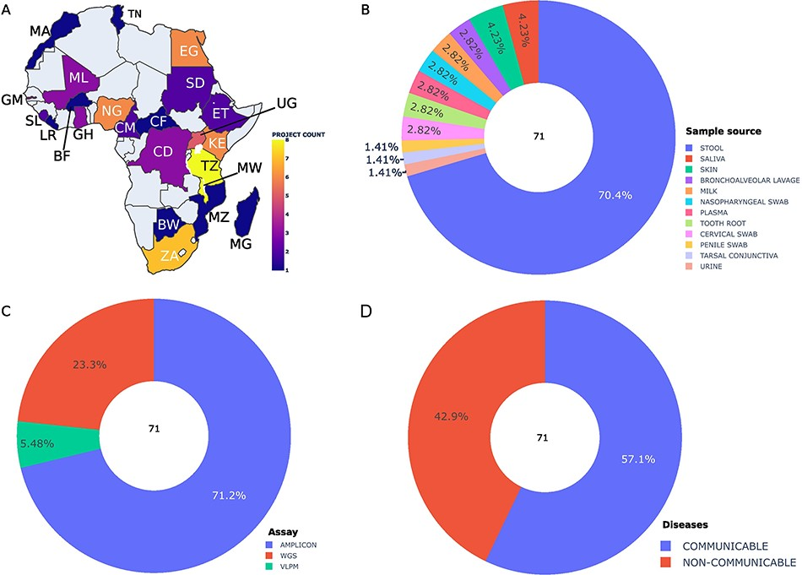
Figure 2. Summary statistics of the collected and integrated metadata by bioprojects. (A) Bioproject distribution ...
Notes:
Figure 2. Summary statistics of the collected and integrated metadata by bioprojects. (A) Bioproject distribution according to African countries (A), body site (B), assay type (C) and diseases (D). Abbreviations: BW: Botswana, BF: Burkina Faso, CM: Cameroon, EG: Egypt, ET: Ethiopia, GH: Ghana, KE: Kenya, LE: Liberia, MG: Madagascar, MW: Malawi, ML: Mali, MA: Morocco, MZ: Mozambique, NG: Nigeria, SL: Sierra Leone, ZA: South Africa, UG: Uganda, CF: Central African Republic, CD: Democratic Republic Of The Congo, GM: Gambia, TZ: Tanzania, TN: Tunisia, SD: Sudan. Alt text Figure 2: Bioproject distribution based on characteristics.
Unless provided in the caption above, the following copyright applies to the content of this slide: © The Author(s) 2024. Published by Oxford University Press.This is an Open Access article distributed under the terms of the Creative Commons Attribution License (https://creativecommons.org/licenses/by/4.0/), which permits unrestricted reuse, distribution, and reproduction in any medium, provided the original work is properly cited.

