Slide 1
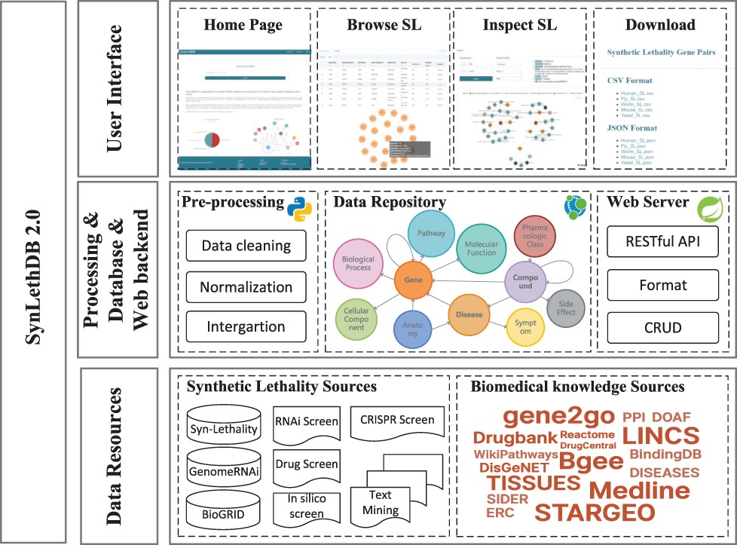
Figure 1. Architecture of SynLethDB 2.0. The bottom layer shows the data sources of SLs and other biomedical knowledge. ...
Notes:
Figure 1. Architecture of SynLethDB 2.0. The bottom layer shows the data sources of SLs and other biomedical knowledge. The middle layer shows the data preprocessing steps, database storage and web server. The top layer shows the main functional modules of the user interface.
Unless provided in the caption above, the following copyright applies to the content of this slide: © The Author(s) 2022. Published by Oxford University Press.This is an Open Access article distributed under the terms of the Creative Commons Attribution-NonCommercial License (https://creativecommons.org/licenses/by-nc/4.0/), which permits non-commercial re-use, distribution, and reproduction in any medium, provided the original work is properly cited. For commercial re-use, please contact journals.permissions@oup.com

Slide 2
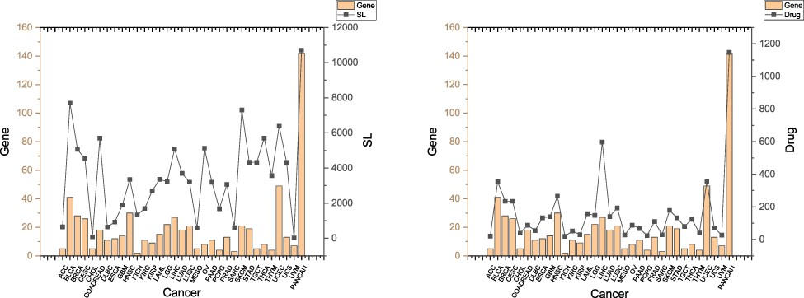
Figure 2. SLs and drugs in SynLethKG for driver genes of 32 cancers and pan-caner. The bar chart shows the numbers of ...
Notes:
Figure 2. SLs and drugs in SynLethKG for driver genes of 32 cancers and pan-caner. The bar chart shows the numbers of cancer driver genes in SynLethKG. In the left figure, the line chart represents the numbers of SLs containing the cancer driver genes in SynLethKG, and in the right figure, the line chart represents the numbers of drugs associated with the driver genes in SynLethKG.
Unless provided in the caption above, the following copyright applies to the content of this slide: © The Author(s) 2022. Published by Oxford University Press.This is an Open Access article distributed under the terms of the Creative Commons Attribution-NonCommercial License (https://creativecommons.org/licenses/by-nc/4.0/), which permits non-commercial re-use, distribution, and reproduction in any medium, provided the original work is properly cited. For commercial re-use, please contact journals.permissions@oup.com

Slide 3
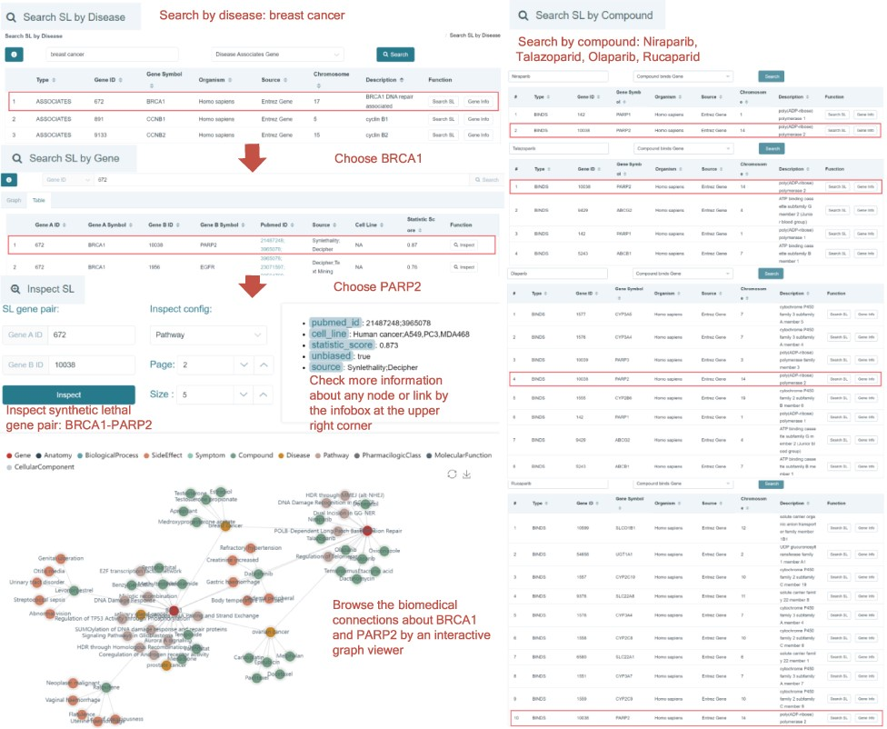
Figure 3. A case study on BRCA1 in breast cancer. Using ‘Search SL by disease’, the SL genes associated with the ...
Notes:
Figure 3. A case study on BRCA1 in breast cancer. Using ‘Search SL by disease’, the SL genes associated with the disease will be shown. BRCA1 is a gene that has SL partners and is downregulated in breast cancer. Click the ‘Search SL’ button, and it shows that PARP2 is an SL partner of BRCA1 with a high confidence score (0.87). Inspecting this pair of SL genes, we notice that BRCA1 and PARP2 are both associated with the ‘ovarian cancer’ and ‘breast cancer’ diseases, and BRCA1 participates in the ‘DNA Damage Response’ pathway. The infobox at the upper right corner shows the annotations of the SL. The synthetic lethal relationship between BRCA1 and PARP2 has been reported in the literature on human cancer and cell lines including A549, PC3 and MDA468. The result that breast cancer downregulates BRCA1 and PARP2 is an SL partner of BRCA1 indicates that PARP2 is a drug target for breast cancer. Rucaparib, Talazoparib, Niraparib and Olaparib all bind with PARP2. Using ‘Search SL by compound’, we also identify PARP2 as a potential drug target of Rucaparib, Talazoparib, Niraparib and Olaparib.
Unless provided in the caption above, the following copyright applies to the content of this slide: © The Author(s) 2022. Published by Oxford University Press.This is an Open Access article distributed under the terms of the Creative Commons Attribution-NonCommercial License (https://creativecommons.org/licenses/by-nc/4.0/), which permits non-commercial re-use, distribution, and reproduction in any medium, provided the original work is properly cited. For commercial re-use, please contact journals.permissions@oup.com

