Slide 1
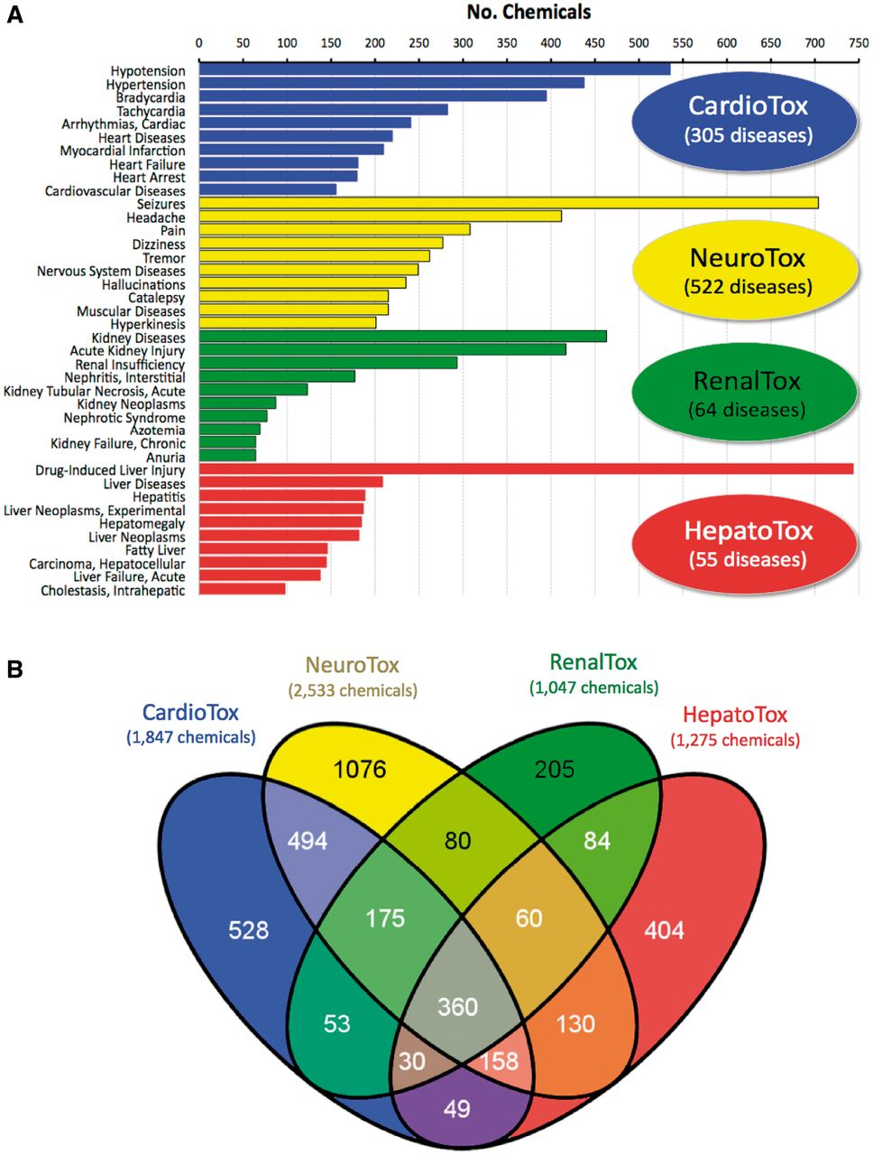
Figure 3. Diseases and chemicals for four system toxicity profiles. (A) The top 10 curated diseases are ranked by the ...
Notes:
Figure 3. Diseases and chemicals for four system toxicity profiles. (A) The top 10 curated diseases are ranked by the number of chemicals curated to each disease for cardiovascular toxicity (CardioTox, blue; 305 diseases), neurological toxicity (NeuroTox, yellow; 522 diseases), kidney toxicity (RenalTox, green; 64 diseases) and liver toxicity (HepatoTox, red; 55 diseases). (B) Venn diagram of 3 886 chemicals associated with CardioTox (blue; 1847 chemicals), NeuroTox (yellow; 2533 chemicals), RenalTox (green; 1047 chemicals) and HepatoTox (red; 1275 chemicals). There are 360 chemicals (center gray subset) common to all four systems.
Unless provided in the caption above, the following copyright applies to the content of this slide: © The Author(s) 2013. Published by Oxford University Press.This is an Open Access article distributed under the terms of the Creative Commons Attribution License (http://creativecommons.org/licenses/by/3.0/), which permits unrestricted reuse, distribution, and reproduction in any medium, provided the original work is properly cited.

