Slide 1
Figure 1. A BEL statement sample from the biocreative V BEL corpus.
Notes:
Figure 1. A BEL statement sample from the biocreative V BEL corpus.
Unless provided in the caption above, the following copyright applies to the content of this slide: © The Author(s) 2016. Published by Oxford University Press. This is an Open Access article distributed under the terms of the Creative Commons Attribution License ( http://creativecommons.org/licenses/by/4.0/ ), which permits unrestricted reuse, distribution, and reproduction in any medium, provided the original work is properly cited.

Slide 2
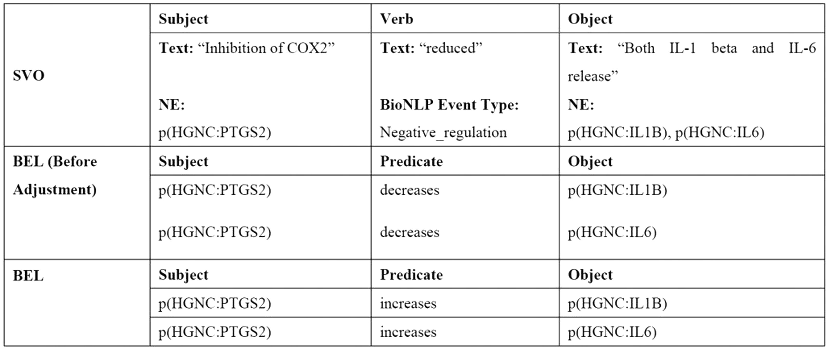
Figure 2. An example of transforming SVO into BEL statement.
Notes:
Figure 2. An example of transforming SVO into BEL statement.
Unless provided in the caption above, the following copyright applies to the content of this slide: © The Author(s) 2016. Published by Oxford University Press. This is an Open Access article distributed under the terms of the Creative Commons Attribution License ( http://creativecommons.org/licenses/by/4.0/ ), which permits unrestricted reuse, distribution, and reproduction in any medium, provided the original work is properly cited.

Slide 3
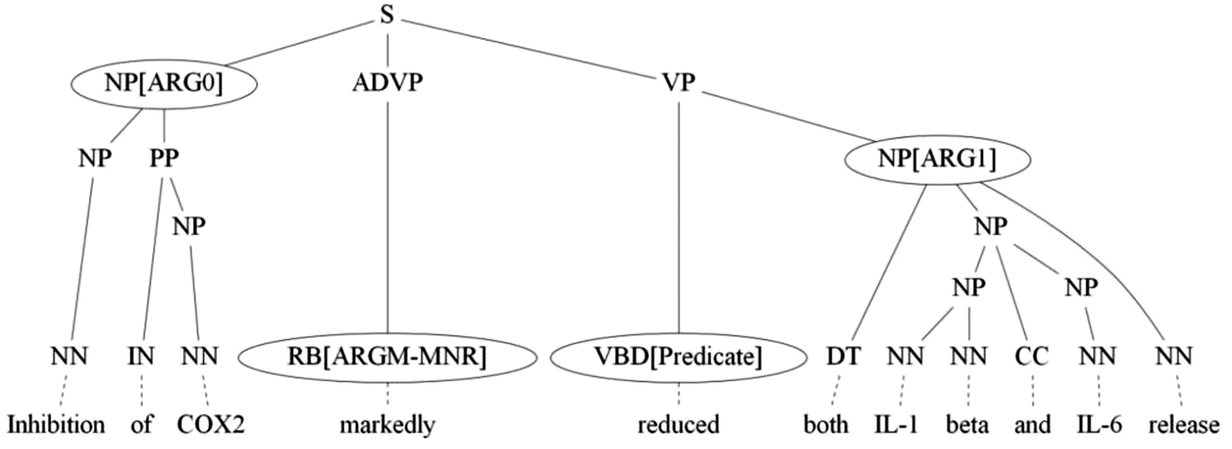
Figure 3. Example of a parse tree annotated with semantic roles.
Notes:
Figure 3. Example of a parse tree annotated with semantic roles.
Unless provided in the caption above, the following copyright applies to the content of this slide: © The Author(s) 2016. Published by Oxford University Press. This is an Open Access article distributed under the terms of the Creative Commons Attribution License ( http://creativecommons.org/licenses/by/4.0/ ), which permits unrestricted reuse, distribution, and reproduction in any medium, provided the original work is properly cited.

Slide 4
Figure 4. An example sentence with incorrect syntactic tree where two verbs ‘downregulated’ and ‘upregulated’ are in ...
Notes:
Figure 4. An example sentence with incorrect syntactic tree where two verbs ‘downregulated’ and ‘upregulated’ are in the sentence.
Unless provided in the caption above, the following copyright applies to the content of this slide: © The Author(s) 2016. Published by Oxford University Press. This is an Open Access article distributed under the terms of the Creative Commons Attribution License ( http://creativecommons.org/licenses/by/4.0/ ), which permits unrestricted reuse, distribution, and reproduction in any medium, provided the original work is properly cited.

Slide 5
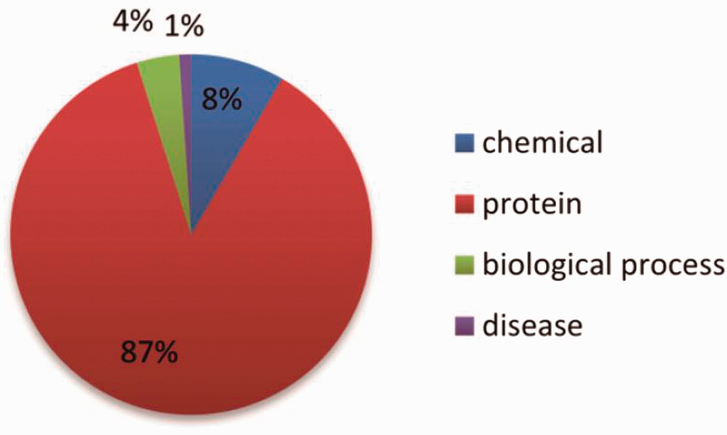
Figure 5. The distribution of the NE types in the training set.
Notes:
Figure 5. The distribution of the NE types in the training set.
Unless provided in the caption above, the following copyright applies to the content of this slide: © The Author(s) 2016. Published by Oxford University Press. This is an Open Access article distributed under the terms of the Creative Commons Attribution License ( http://creativecommons.org/licenses/by/4.0/ ), which permits unrestricted reuse, distribution, and reproduction in any medium, provided the original work is properly cited.

Slide 6
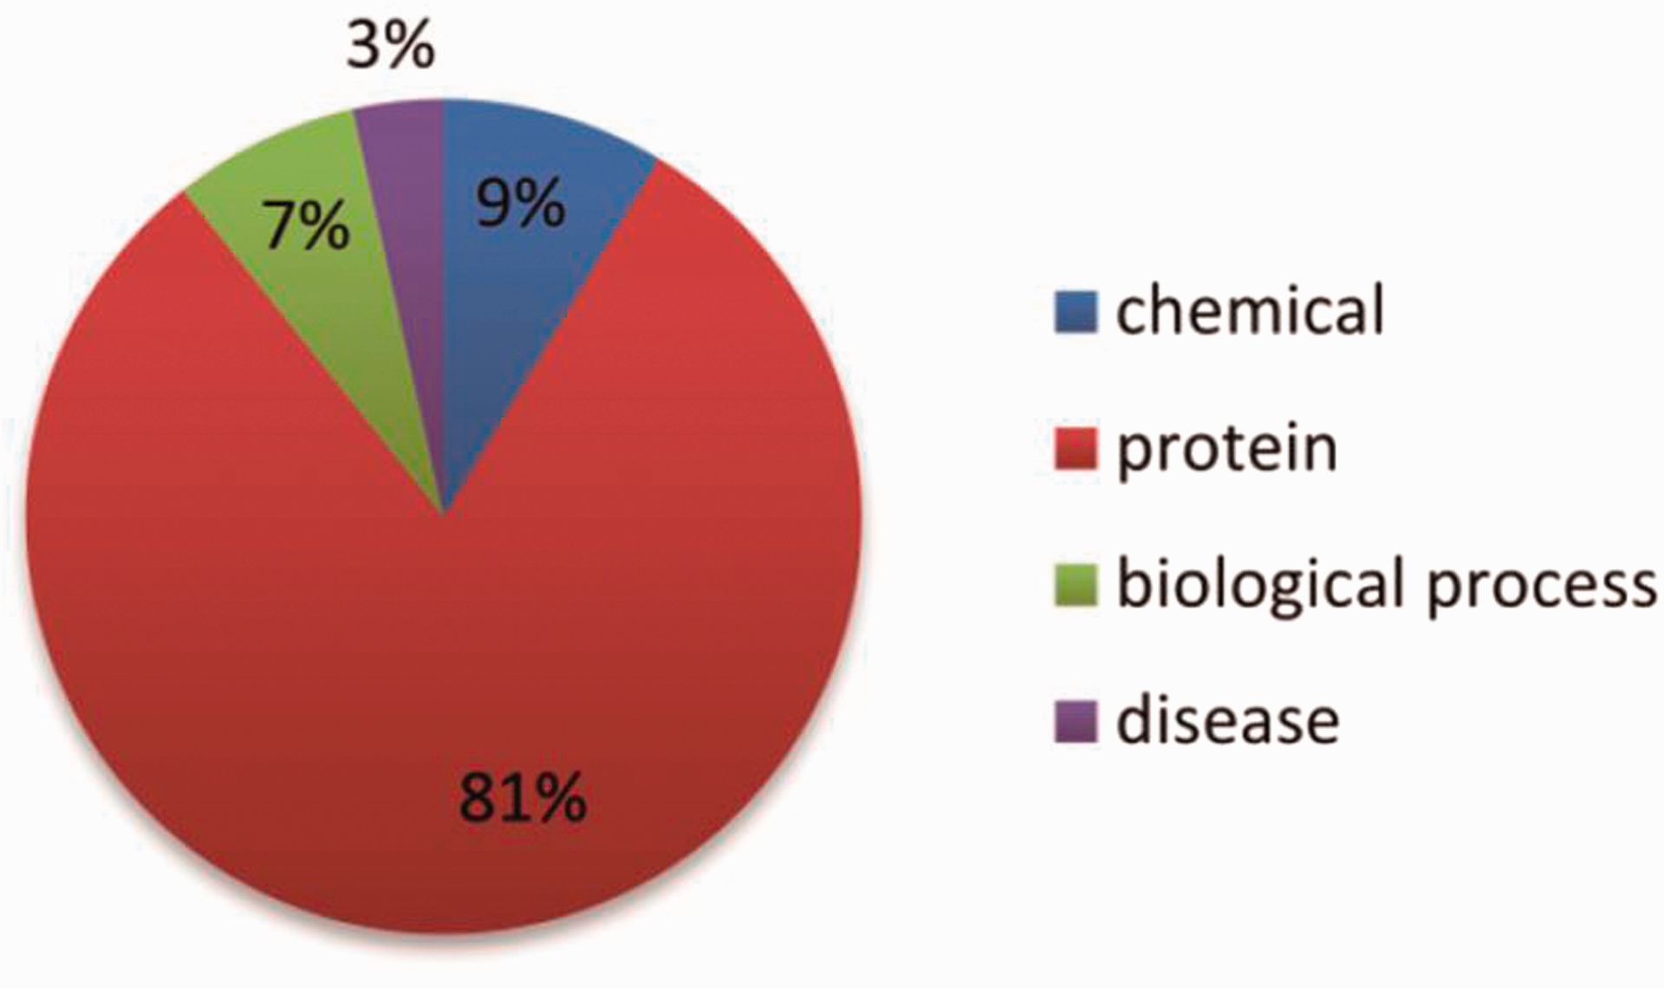
Figure 6. The distribution of the NE types in the test set.
Notes:
Figure 6. The distribution of the NE types in the test set.
Unless provided in the caption above, the following copyright applies to the content of this slide: © The Author(s) 2016. Published by Oxford University Press. This is an Open Access article distributed under the terms of the Creative Commons Attribution License ( http://creativecommons.org/licenses/by/4.0/ ), which permits unrestricted reuse, distribution, and reproduction in any medium, provided the original work is properly cited.

