Slide 1
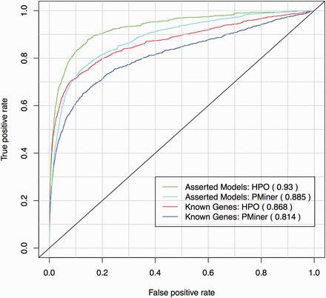
Figure 5. ROC curve for known gene-disease associations from OMIM’s MorbidMap using HP and PhenoMiner annotations. For ...
Notes:
Figure 5. ROC curve for known gene-disease associations from OMIM’s MorbidMap using HP and PhenoMiner annotations. For each disease the true- and false-positive rate is calculated from the list of mouse genes in MGD ordered by phenotypic similarity and the known associated gene in OMIM.
Unless provided in the caption above, the following copyright applies to the content of this slide: © The Author(s) 2015. Published by Oxford University Press. This is an Open Access article distributed under the terms of the Creative Commons Attribution License ( http://creativecommons.org/licenses/by/4.0/ ), which permits unrestricted reuse, distribution, and reproduction in any medium, provided the original work is properly cited.

