Slide 1
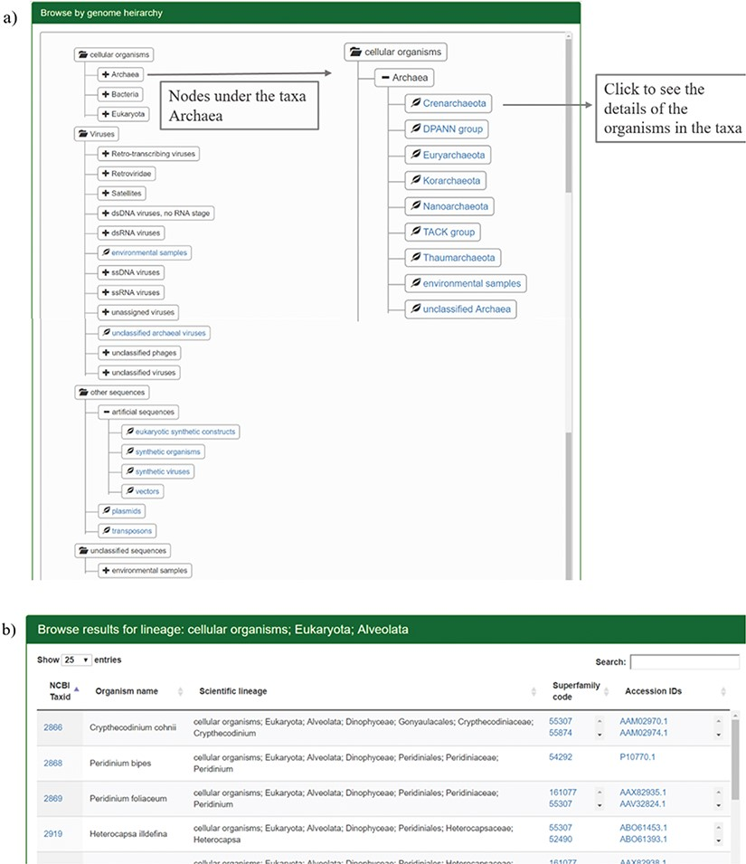
Figure 2 Results for browsing by taxonomy. (a) The taxonomy page lists the superphyla, phyla and family under ...
Notes:
Figure 2 Results for browsing by taxonomy. (a) The taxonomy page lists the superphyla, phyla and family under different categories like cellular organisms, viruses, unclassified sequences and artificial sequences. The users can click on the parent nodes to expand the contents. Clicking on the child nodes with a leaf sign leads to a page listing all the species in the node with the complete hierarchy, accession ids and SCOP superfamilies of homologues. Links have been provided to NCBI taxonomy database on clicking the taxids and GenBank/Refseq page on clicking protein accession ids. Results for the expanded branch of the kingdom `Archaea’ has been shown. (b) Users can also browse the database using names for taxa, phyla, family etc. An example for search result of the keyword `Alveolata’ is shown.
Unless provided in the caption above, the following copyright applies to the content of this slide: © The Author(s) 2019. Published by Oxford University Press.This is an Open Access article distributed under the terms of the Creative Commons Attribution License (http://creativecommons.org/licenses/by/4.0/), which permits unrestricted reuse, distribution, and reproduction in any medium, provided the original work is properly cited.

