Slide 1
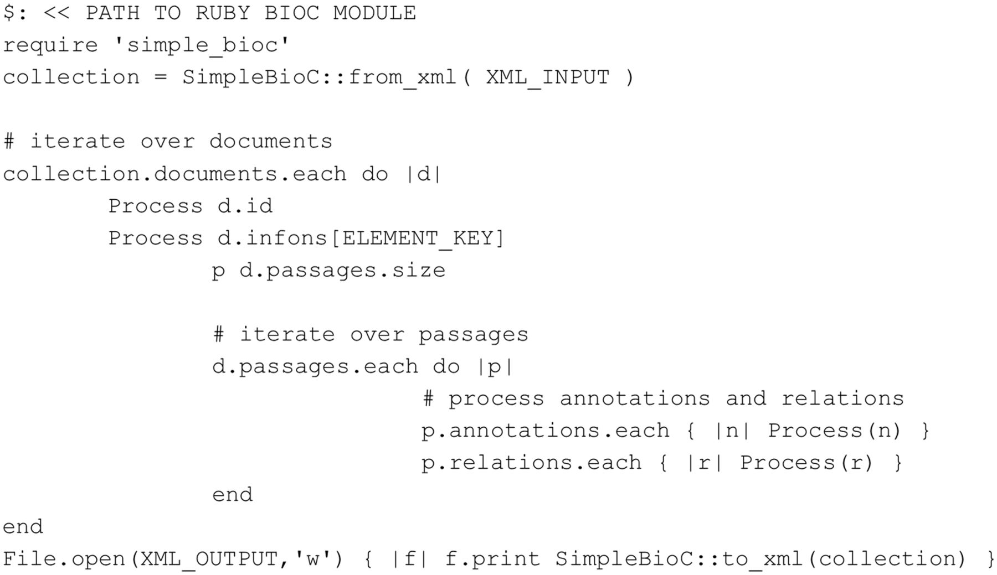
Figure 8. Ruby code accessing BioC data (tested with Ruby 2.0.0).
Notes:
Figure 8. Ruby code accessing BioC data (tested with Ruby 2.0.0).
Unless provided in the caption above, the following copyright applies to the content of this slide: Published by Oxford University Press 2014. This work is written by US Government employees and is in the public domain in the US.

