Slide 1
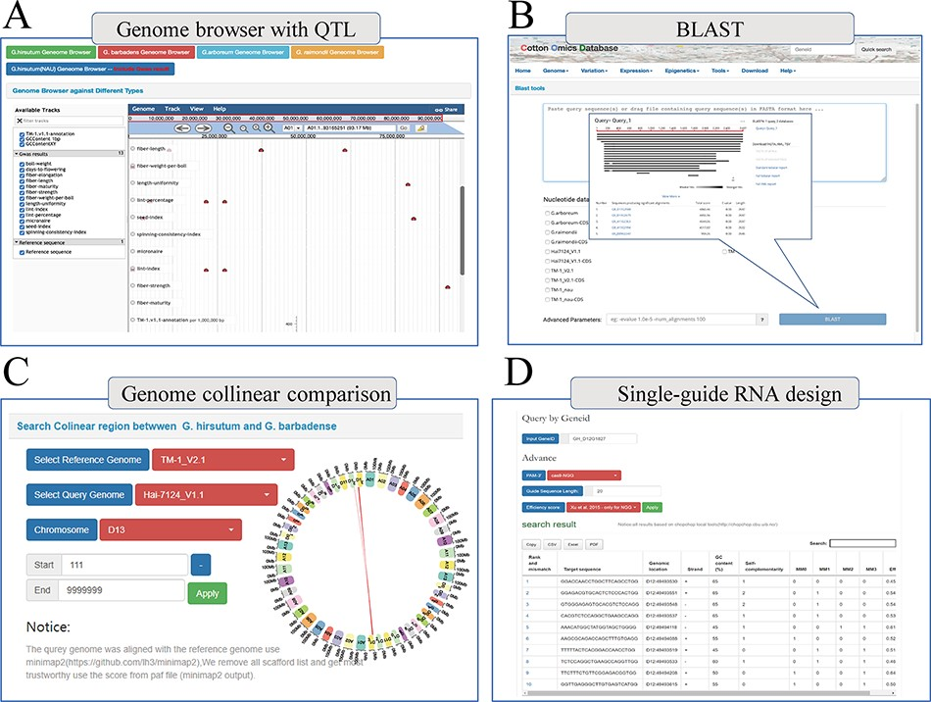
Figure 5. Multi-online bioinformatics tools. Genome browser for multiple cotton species. (B) Online blast tools; users ...
Notes:
Figure 5. Multi-online bioinformatics tools. Genome browser for multiple cotton species. (B) Online blast tools; users can blast against multiple cotton genome databases based on nucleic acid sequence and protein sequence. (C) Genome collinear comparison query interface; the interface provided circle graphs to show the collinearity of the genome, and users can also download the table to view these collinearity segments information. (D) Single-guide RNA design tools; the interface allows users to design single-guide RNA based on gene loci or chromosome location; furthermore, we also provide a variety of scoring strategies for users to evaluate the efficiency.
Unless provided in the caption above, the following copyright applies to the content of this slide: © The Author(s) 2022. Published by Oxford University Press.This is an Open Access article distributed under the terms of the Creative Commons Attribution-NonCommercial License (https://creativecommons.org/licenses/by-nc/4.0/), which permits non-commercial re-use, distribution, and reproduction in any medium, provided the original work is properly cited. For commercial re-use, please contact journals.permissions@oup.com

