Slide 1
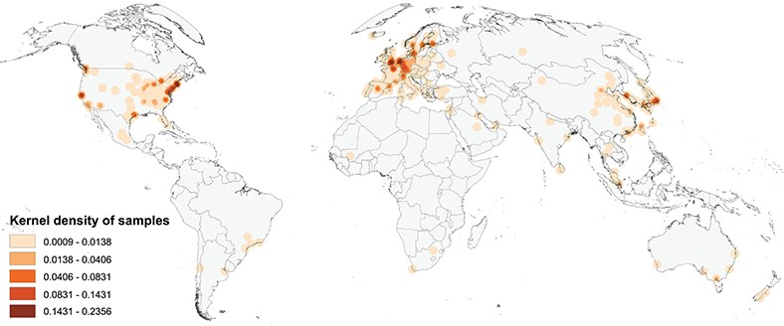
Figure 1 Map of the geographic distribution of genome screening experiments using the first author affiliation ...
Notes:
Figure 1 Map of the geographic distribution of genome screening experiments using the first author affiliation location proxy, derived from 3240 publications registered in the Progenetix database, including 104 543 genomic array, 36 766 cCGH and 15 409 whole genome/exome-based cancer genome profiles. The map is rendered in the Goode Homolosine Land equal area projection (kernel density per square kilometer).
Unless provided in the caption above, the following copyright applies to the content of this slide: © The Author(s) 2020. Published by Oxford University Press.This is an Open Access article distributed under the terms of the Creative Commons Attribution License (http://creativecommons.org/licenses/by/4.0/), which permits unrestricted reuse, distribution, and reproduction in any medium, provided the original work is properly cited.

