Slide 1
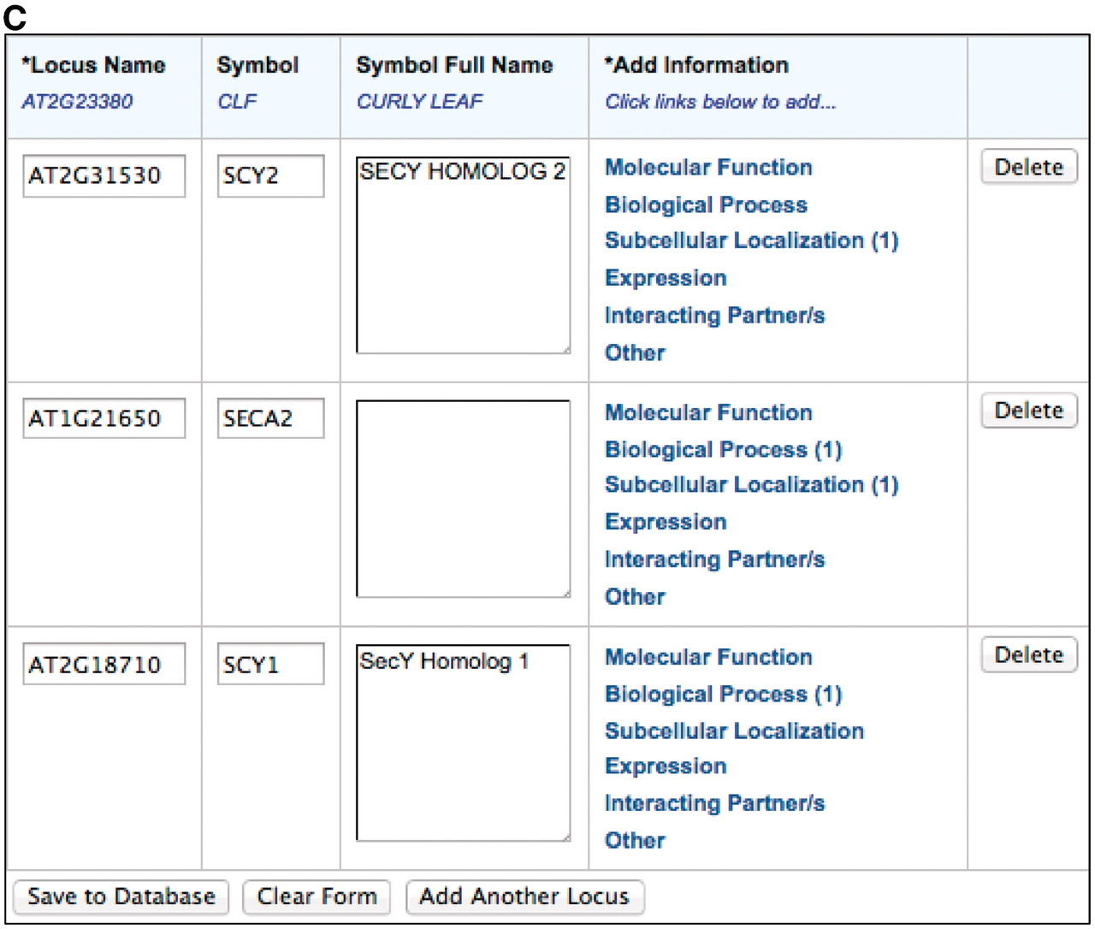
Figure 1. The TOAST interface. (A) Initial page that requests stable article identifiers and locus identifiers. Users ...
Notes:
Figure 1. The TOAST interface. (A) Initial page that requests stable article identifiers and locus identifiers. Users can then add annotations in six different areas, five of which are controlled vocabularies. (B) The subcellular localization data entry form. Submissions are aided by an auto-complete functionality which suggests terms that match the user's entry. Once selected, the appropriate stable id for the ontology term is also captured but not displayed to the submitter. Users can also enter terms not in the suggestion list. (C) Form with data ready for submission. At this stage the user may add additional loci or annotations or complete the submission process by saving to the curation database.
Unless provided in the caption above, the following copyright applies to the content of this slide: © The Author(s) 2012. Published by Oxford University Press.This is an Open Access article distributed under the terms of the Creative Commons Attribution Non-Commercial License (http://creativecommons.org/licenses/by-nc/3.0), which permits unrestricted non-commercial use, distribution, and reproduction in any medium, provided the original work is properly cited.

