Slide 1
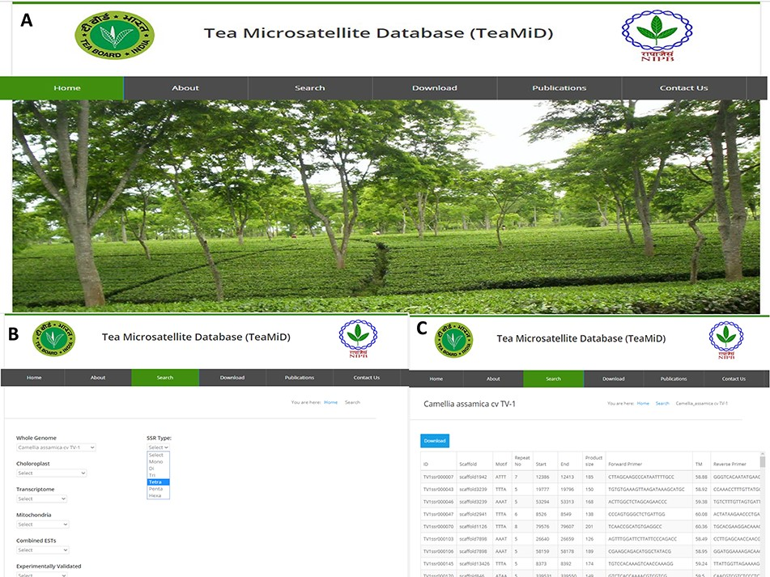
Figure 9 Database of tea SSR (TeaMiD) (a) front page of the database, (b) ‘Search’ page of the database indicating ...
Notes:
Figure 9 Database of tea SSR (TeaMiD) (a) front page of the database, (b) ‘Search’ page of the database indicating various option, (c) example of CA SSR page under the ‘whole genome’ search option.
Unless provided in the caption above, the following copyright applies to the content of this slide: © The Author(s) 2020. Published by Oxford University Press.This is an Open Access article distributed under the terms of the Creative Commons Attribution License (http://creativecommons.org/licenses/by/4.0/), which permits unrestricted reuse, distribution, and reproduction in any medium, provided the original work is properly cited.

