Slide 1
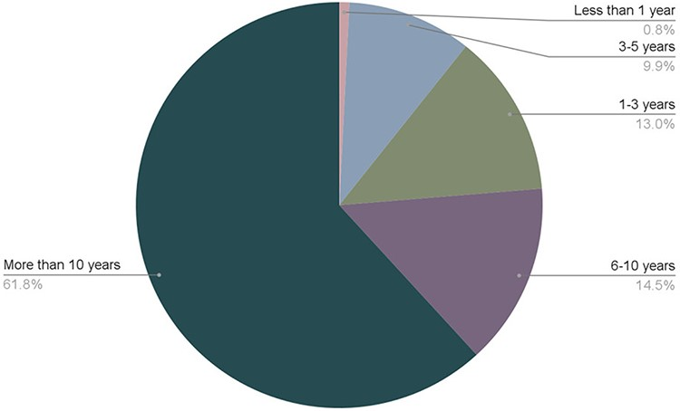
Figure 2. Length of time that ISB community members have been in their career. 131 respondents participated in the ...
Notes:
Figure 2. Length of time that ISB community members have been in their career. 131 respondents participated in the survey. The full original dataset is available in Zenodo (2).
Unless provided in the caption above, the following copyright applies to the content of this slide: © The Author(s) 2022. Published by Oxford University Press.This is an Open Access article distributed under the terms of the Creative Commons Attribution License (https://creativecommons.org/licenses/by/4.0/), which permits unrestricted reuse, distribution, and reproduction in any medium, provided the original work is properly cited.

