Slide 1
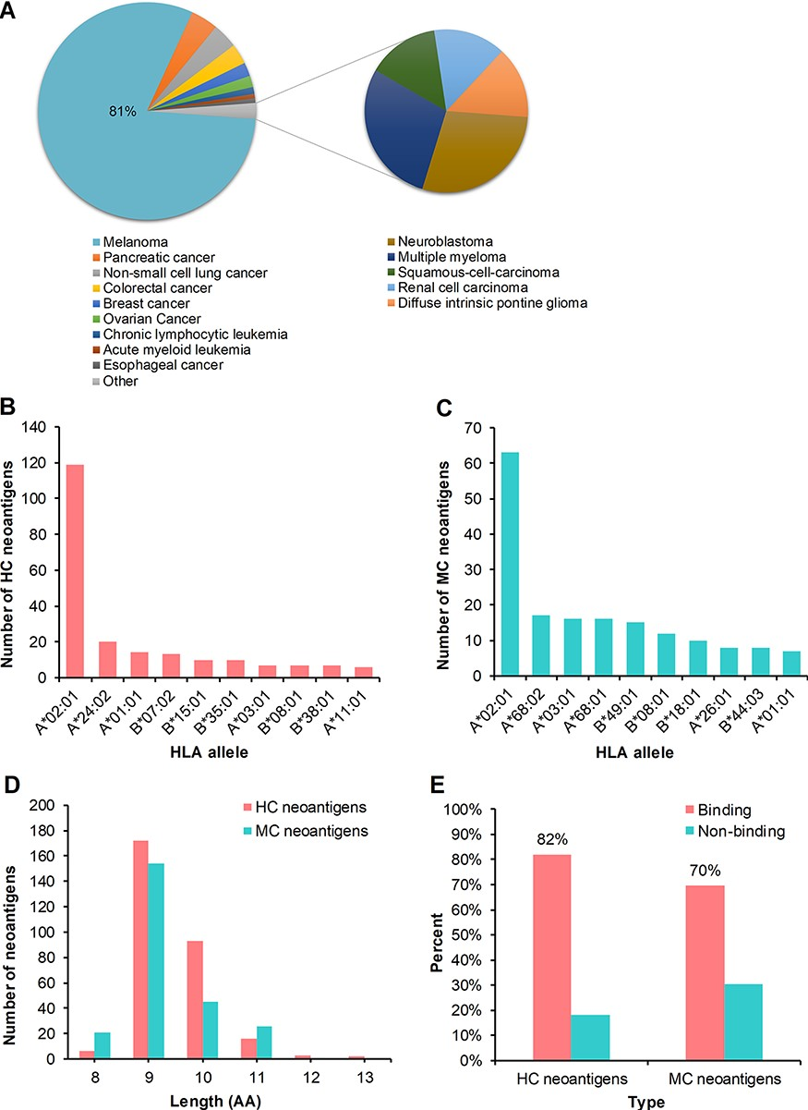
Figure 3 Statistics analysis of the collected peptides in dbPepNeo. (A) Distribution of high confidence neoantigens. ...
Notes:
Figure 3 Statistics analysis of the collected peptides in dbPepNeo. (A) Distribution of high confidence neoantigens. (B) Top 10 HLA alleles matched with high confidence neoantigens. (C) Top 10 HLA alleles matched with medium confidence neoantigens. (D) The number of medium confidence neoantigens and high confidence neoantigens based on the length of amino acid. (E) Affinity prediction with NetMHCpan of medium confidence neoantigens and high confidence neoantigens.
Unless provided in the caption above, the following copyright applies to the content of this slide: © The Author(s) 2020. Published by Oxford University Press.This is an Open Access article distributed under the terms of the Creative Commons Attribution License (http://creativecommons.org/licenses/by/4.0/), which permits unrestricted reuse, distribution, and reproduction in any medium, provided the original work is properly cited.

