Slide 1
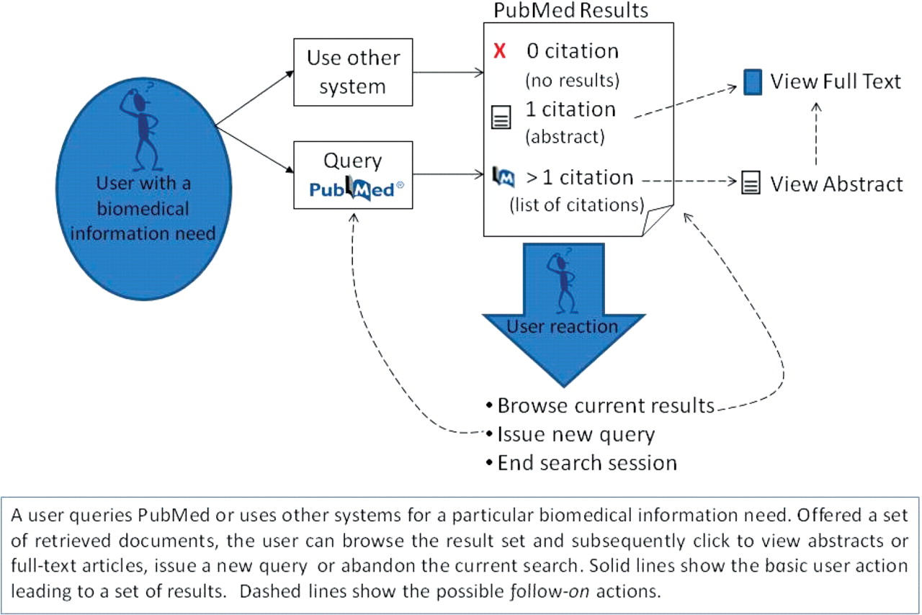
Figure 1. An overview of user interactions with PubMed. A user queries PubMed or uses other systems for a particular ...
Notes:
Figure 1. An overview of user interactions with PubMed. A user queries PubMed or uses other systems for a particular biomedical information need. Offered a set of retrieved documents, the user can browse the result set and subsequently click to view abstracts or full-text articles, issue a new query or abandon the current search. Solid lines show the basic user action leading to a set of results. Dashed lines show the possible follow-on actions.
Unless provided in the caption above, the following copyright applies to the content of this slide: © The Author(s) 2009. Published by Oxford University Press.This is Open Access article distributed under the terms of the Creative Commons Attribution Non-Commercial License (http://creativecommons.org/licenses/by-nc/2.5/uk/) which permits unrestricted non-commercial use, distribution, and reproduction in any medium, provided the original work is properly cited.

