Slide 1
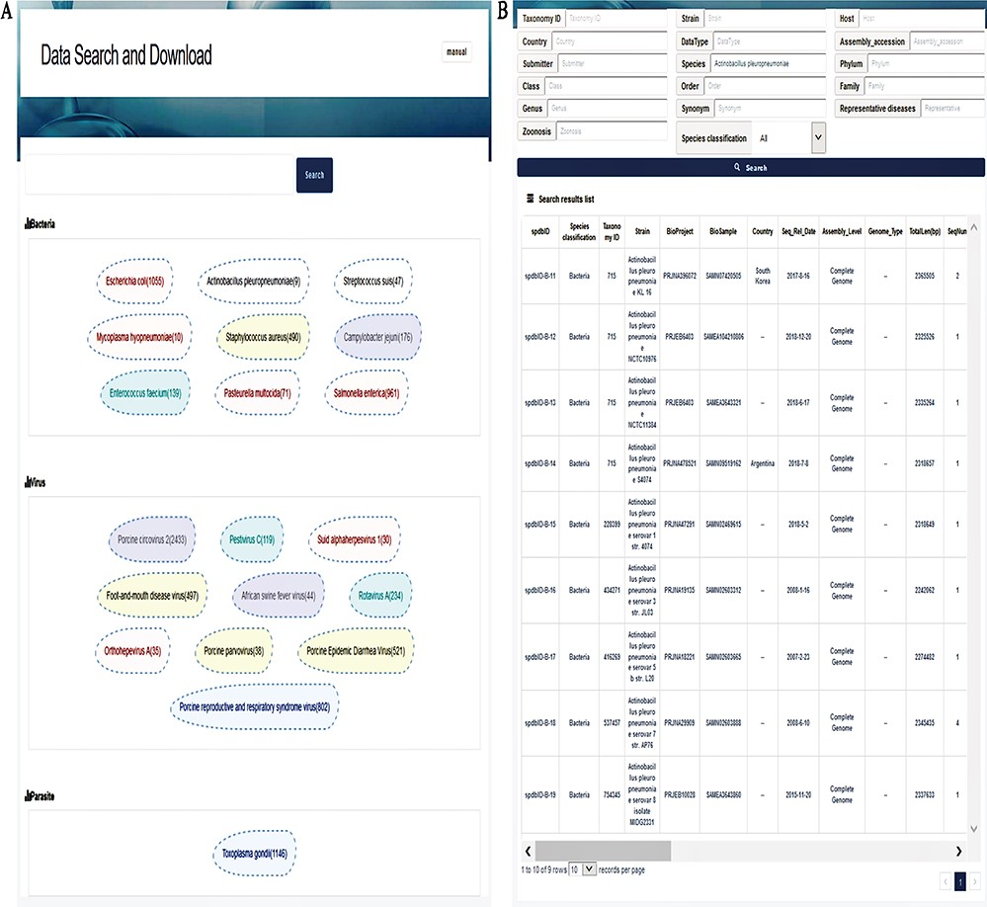
Figure 3 Interfaces of data search and download system. (A) Search page. A search box on the top is for a ...
Notes:
Figure 3 Interfaces of data search and download system. (A) Search page. A search box on the top is for a keyword-based search for quick and focused searches; clicking on the search without character input in the search box will allow the user to enter accurate and customized searches; the next section displays the top 20 hot words for each category, which can be directly linked to the corresponding data. (B) Search result page. The top of this page shows an option for advanced search, allowing the user to search the target using 17 fields to find the appropriate information more accurately. The bottom section represents the search result list, with 30 fields listed in total.
Unless provided in the caption above, the following copyright applies to the content of this slide: © The Author(s) 2020. Published by Oxford University Press.This is an Open Access article distributed under the terms of the Creative Commons Attribution License (http://creativecommons.org/licenses/by/4.0/), which permits unrestricted reuse, distribution, and reproduction in any medium, provided the original work is properly cited.

