Slide 1
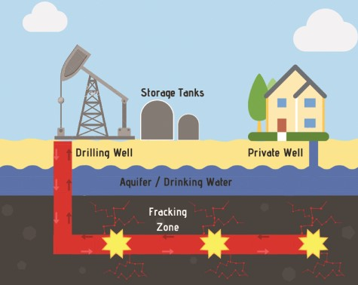
Figure 1 Schematic detailing the hydraulic fracturing process. The well is drilled vertically downward to a certain ...
Notes:
Figure 1 Schematic detailing the hydraulic fracturing process. The well is drilled vertically downward to a certain depth up to 5000 ft (reported as the well drill depth) and then horizontally radiating out by 1–2 miles (not reported by FracFocus). The fracking occurs in the horizontal space after perforating the casing and delivering proppant (sand or silica plus hydraulic fracturing fluid) to keep the fissures open releasing the oil or gas kept in the shale within the earth.
Unless provided in the caption above, the following copyright applies to the content of this slide: © The Author(s) 2020. Published by Oxford University Press.This is an Open Access article distributed under the terms of the Creative Commons Attribution License (http://creativecommons.org/licenses/by/4.0/), which permits unrestricted reuse, distribution, and reproduction in any medium, provided the original work is properly cited.

