Slide 1
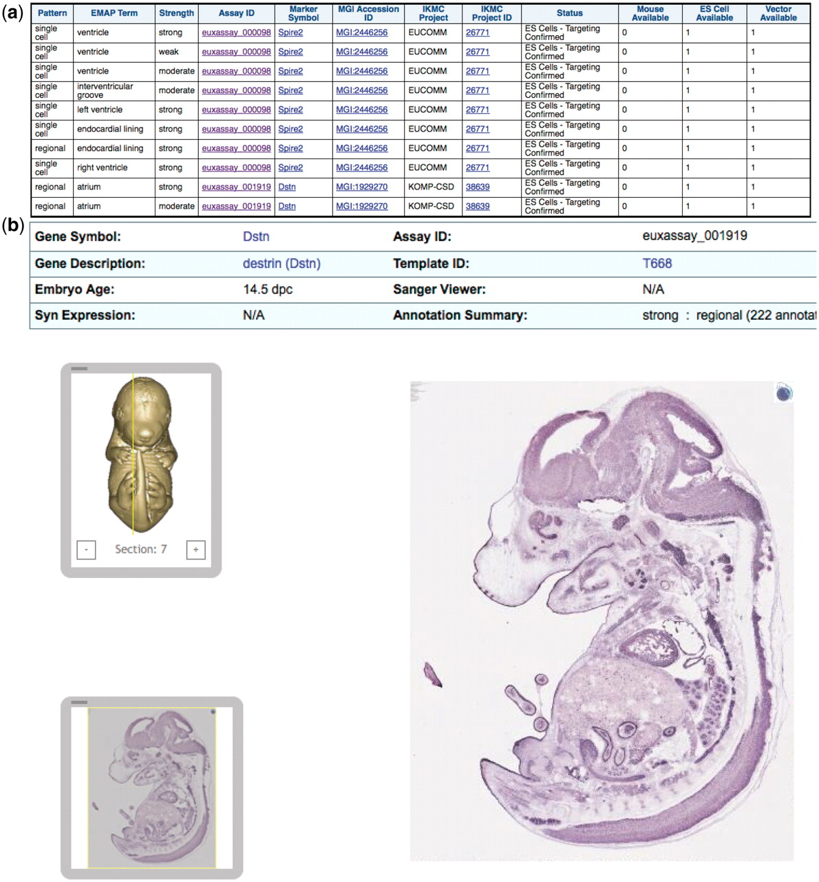
Figure 2. IKMC resources for genes expressed in embryonic heart or sub-structures according to the Eurexpress in situ ...
Notes:
Figure 2. IKMC resources for genes expressed in embryonic heart or sub-structures according to the Eurexpress in situ expression database: (a) results of a query involving the in situ expression dataset from Eurexpress and the IKMC projects/alleles dataset, (b) further detail of the expression patterns at the main Eurexpress website after linking from one of the Assay ID results above.
Unless provided in the caption above, the following copyright applies to the content of this slide: © The Author(s) 2011. Published by Oxford University Press.This is Open Access article distributed under the terms of the Creative Commons Attribution Non-Commercial License (http://creativecommons.org/licenses/by-nc/2.5), which permits unrestricted non-commercial use, distribution, and reproduction in any medium, provided the original work is properly cited.

