Slide 1
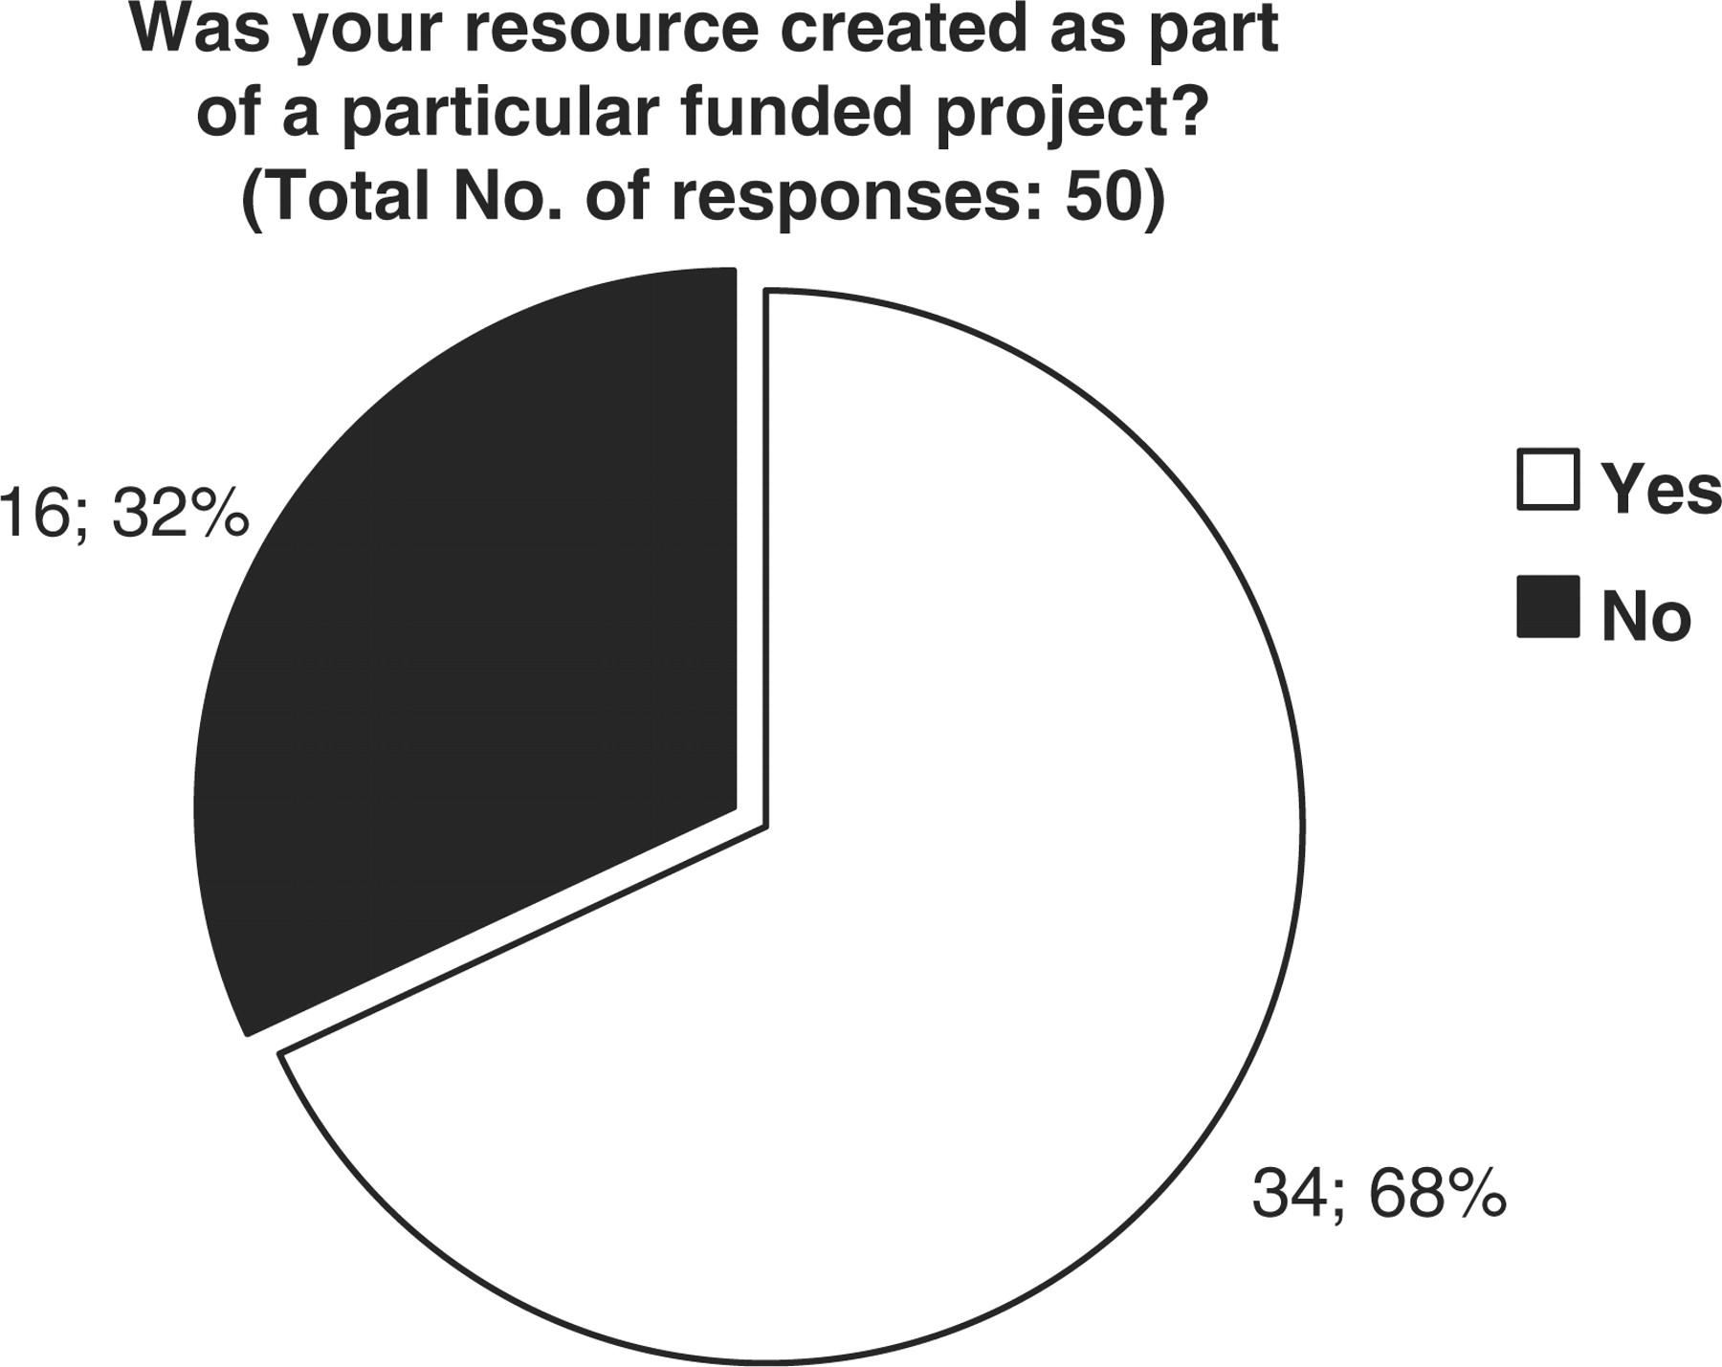
Figure 3. Representation of the financial support originally obtained for the creation of each biological database or ...
Notes:
Figure 3. Representation of the financial support originally obtained for the creation of each biological database or resource. 68 percent of resources were created as part of a particular funded project, while 32% were not.
Unless provided in the caption above, the following copyright applies to the content of this slide: © The Author(s) 2009. Published by Oxford University Press.This is Open Access article distributed under the terms of the Creative Commons Attribution Non-Commercial License (http://creativecommons.org/licenses/by-nc/2.5/uk/) which permits unrestricted non-commercial use, distribution, and reproduction in any medium, provided the original work is properly cited.

