Slide 1
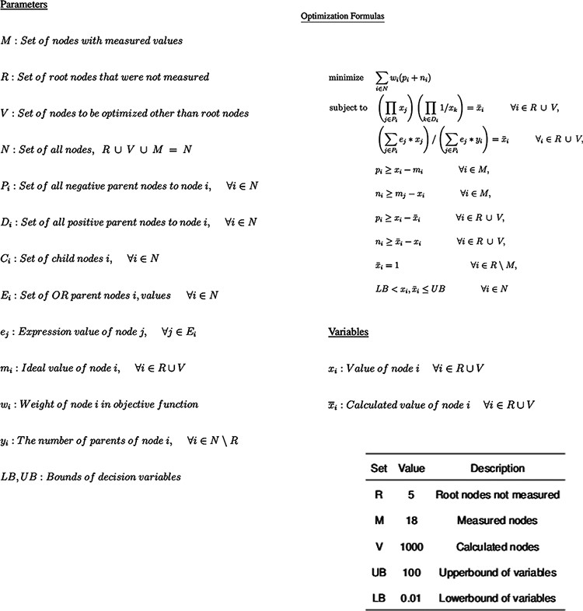
Figure 2. Optimization Model for inferring perturbation impact on pathway nodes. The top is the parameters available in ...
Notes:
Figure 2. Optimization Model for inferring perturbation impact on pathway nodes. The top is the parameters available in the model, followed by the non-linear model itself and then by the fixed parameter values.
Unless provided in the caption above, the following copyright applies to the content of this slide: © The Author(s) 2022. Published by Oxford University Press.This is an Open Access article distributed under the terms of the Creative Commons Attribution License (https://creativecommons.org/licenses/by/4.0/), which permits unrestricted reuse, distribution, and reproduction in any medium, provided the original work is properly cited.

