Slide 1
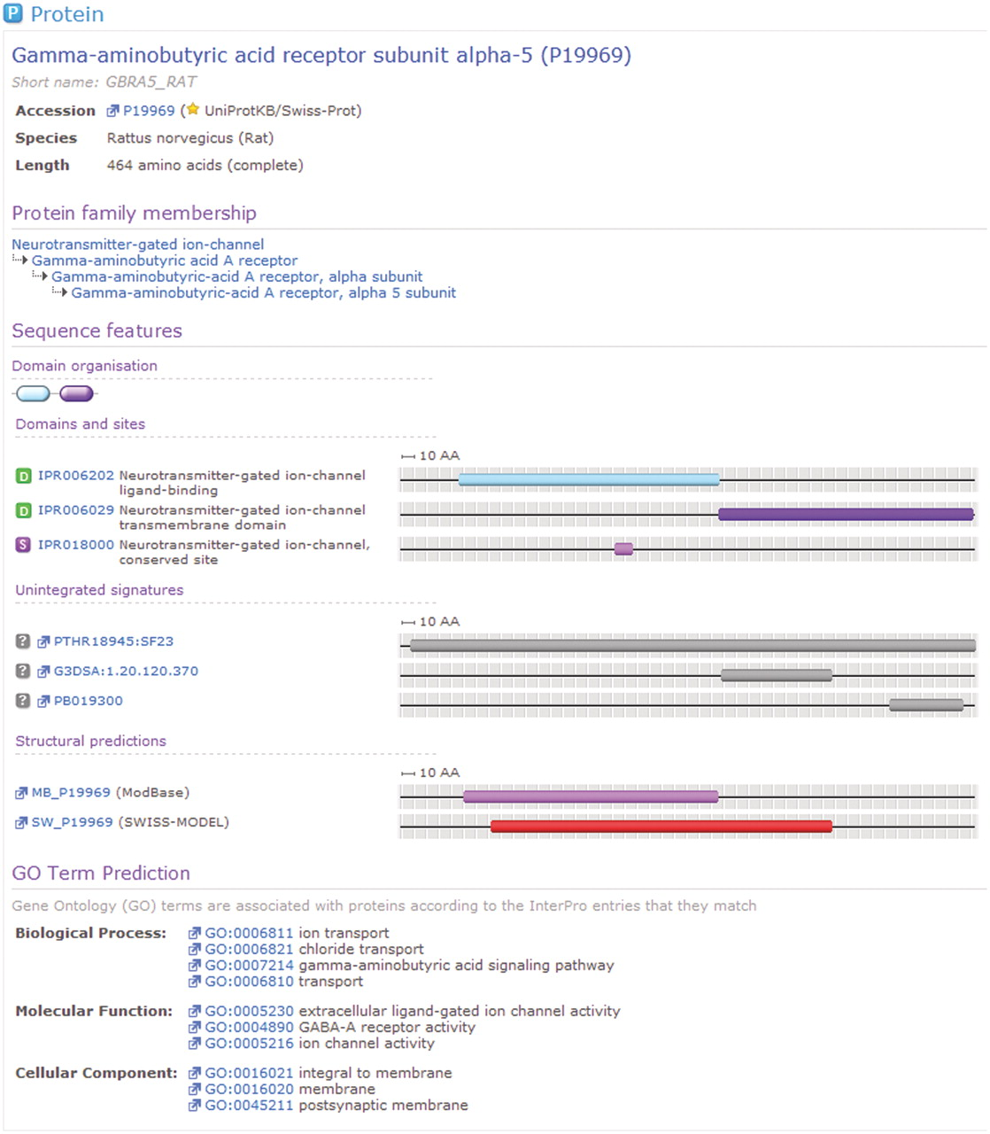
Figure 2. A protein for which matches have been calculated by InterPro. For this sequence, InterPro provides a ...
Notes:
Figure 2. A protein for which matches have been calculated by InterPro. For this sequence, InterPro provides a prediction of protein family membership, an overview of the domain organization and the details of matches to member database signatures. At the foot of the view can be seen associated GO terms, based upon the calculated matches to InterPro entries.
Unless provided in the caption above, the following copyright applies to the content of this slide: © The Author(s) 2011. Published by Oxford University Press.This is Open Access article distributed under the terms of the Creative Commons Attribution Non-Commercial License (http://creativecommons.org/licenses/by-nc/2.5), which permits unrestricted non-commercial use, distribution, and reproduction in any medium, provided the original work is properly cited.

