Slide 1
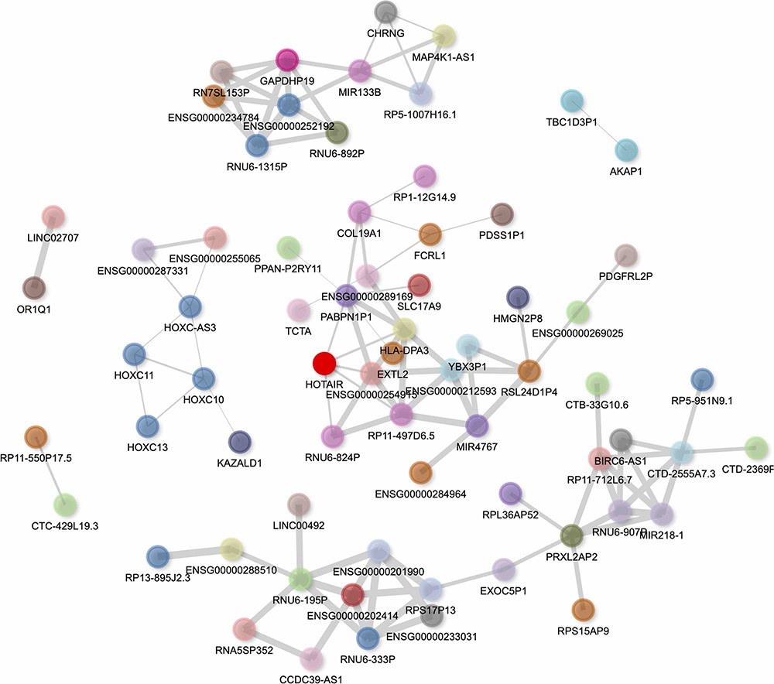
Figure 6. Interactive gene–gene co-expression network for the lncRNA HOTAIR. The HOTAIR gene–gene co-expression network ...
Notes:
Figure 6. Interactive gene–gene co-expression network for the lncRNA HOTAIR. The HOTAIR gene–gene co-expression network contains the top 100 genes most correlated with HOTAIR. The thickness of the edges represents the magnitude of the PCCs, and nodes representing genes are colored by their chromosome of origin except for the queried lncRNA, which is colored in bright red. The network is pruned so that each node on average has less than three edges.
Unless provided in the caption above, the following copyright applies to the content of this slide: © The Author(s) 2023. Published by Oxford University Press.This is an Open Access article distributed under the terms of the Creative Commons Attribution License (https://creativecommons.org/licenses/by/4.0/), which permits unrestricted reuse, distribution, and reproduction in any medium, provided the original work is properly cited.

