Slide 1
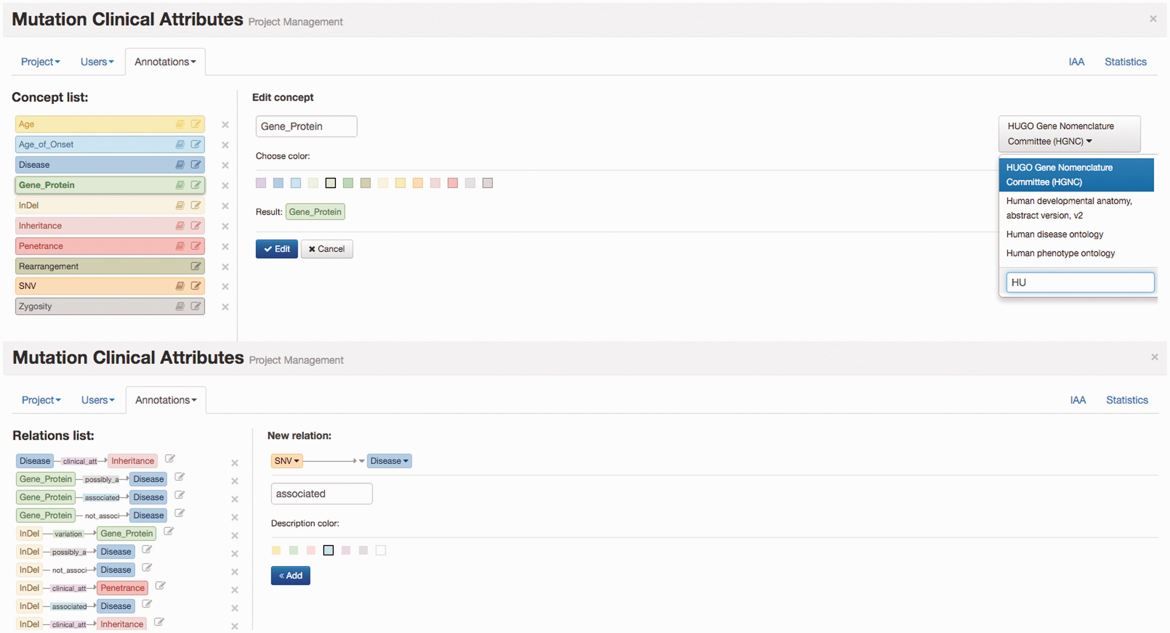
Figure 1. Egas administration panel illustrating the definition of concept type ‘Gene_Protein’ linked to HGNC for ...
Notes:
Figure 1. Egas administration panel illustrating the definition of concept type ‘Gene_Protein’ linked to HGNC for normalization, and of the ‘associated’ relation between ‘SNV’ and ‘Disease’ concepts.
Unless provided in the caption above, the following copyright applies to the content of this slide: © The Author(s) 2016. Published by Oxford University Press. This is an Open Access article distributed under the terms of the Creative Commons Attribution License ( http://creativecommons.org/licenses/by/4.0/ ), which permits unrestricted reuse, distribution, and reproduction in any medium, provided the original work is properly cited.

Slide 2
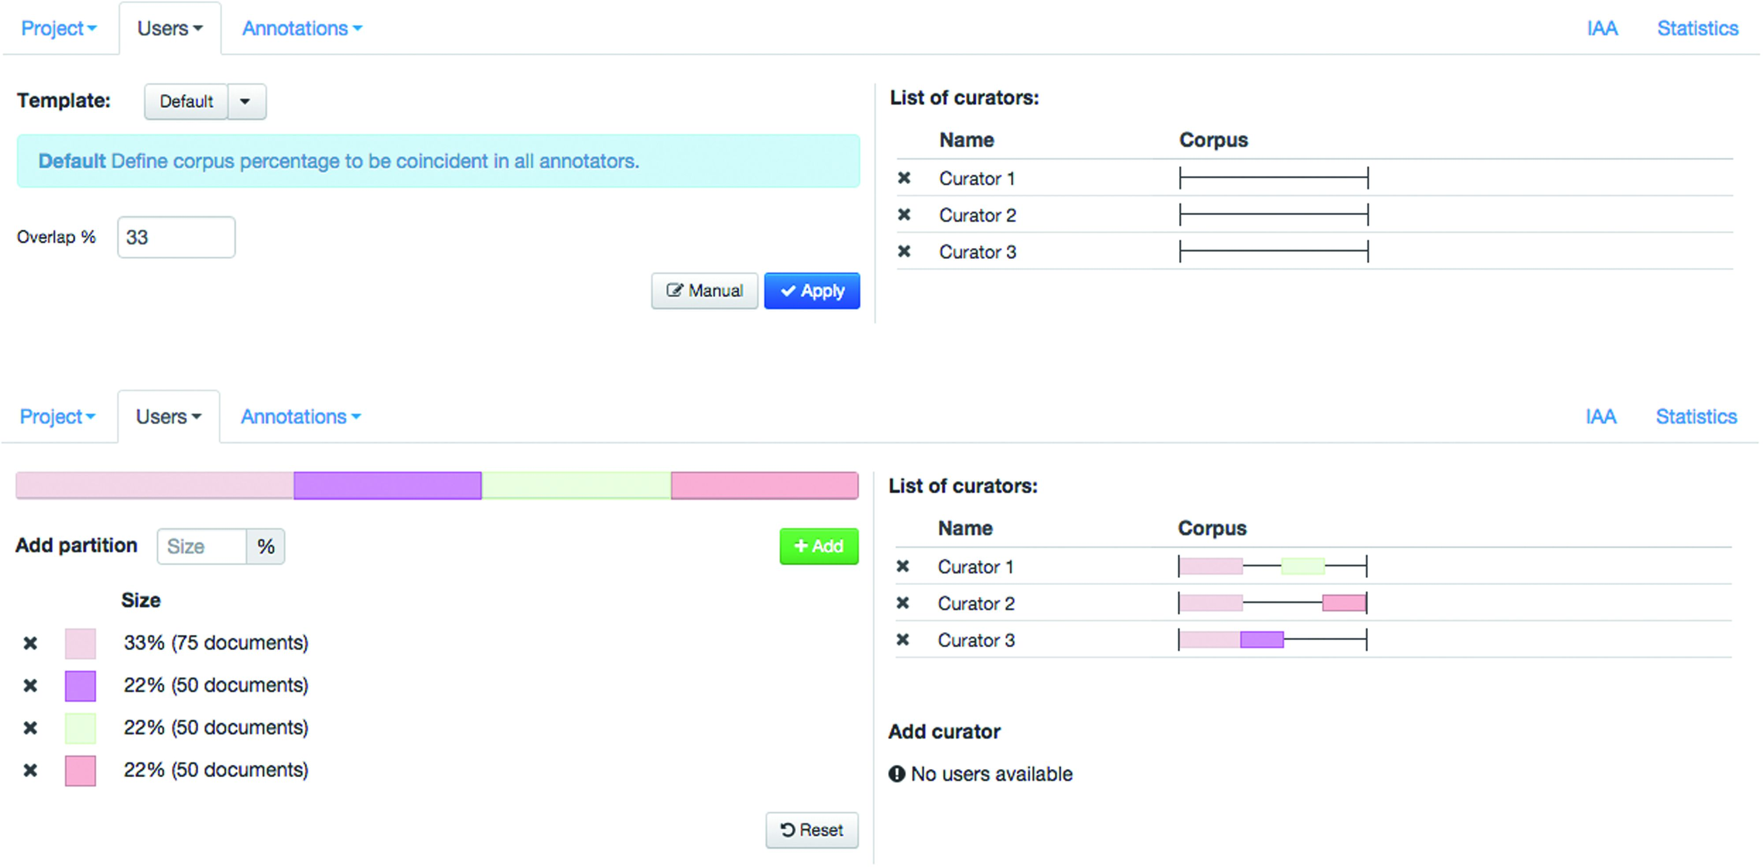
Figure 2. Administration interface showing the definition and assignment of corpus partition to curators.
Notes:
Figure 2. Administration interface showing the definition and assignment of corpus partition to curators.
Unless provided in the caption above, the following copyright applies to the content of this slide: © The Author(s) 2016. Published by Oxford University Press. This is an Open Access article distributed under the terms of the Creative Commons Attribution License ( http://creativecommons.org/licenses/by/4.0/ ), which permits unrestricted reuse, distribution, and reproduction in any medium, provided the original work is properly cited.

Slide 3
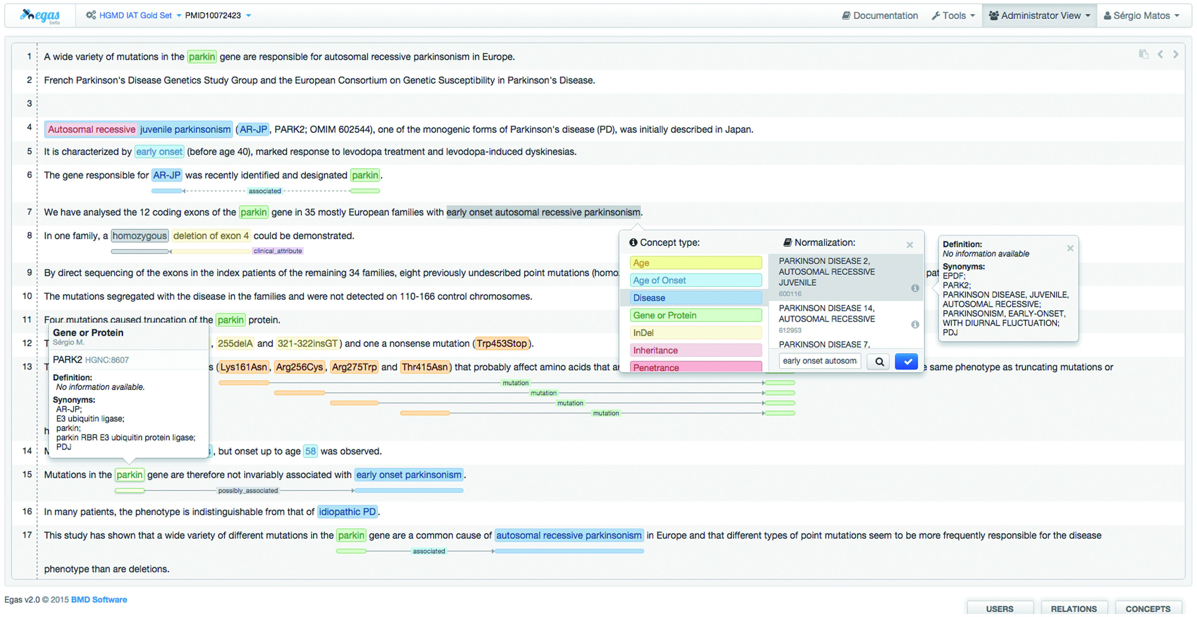
Figure 3. Egas annotation interface illustrating the addition of a new concept annotation of type ‘Disease’, and its ...
Notes:
Figure 3. Egas annotation interface illustrating the addition of a new concept annotation of type ‘Disease’, and its normalization to an OMIM concept. A concept information tooltip is shown when hovering the mouse pointer over an existing annotation.
Unless provided in the caption above, the following copyright applies to the content of this slide: © The Author(s) 2016. Published by Oxford University Press. This is an Open Access article distributed under the terms of the Creative Commons Attribution License ( http://creativecommons.org/licenses/by/4.0/ ), which permits unrestricted reuse, distribution, and reproduction in any medium, provided the original work is properly cited.

Slide 4
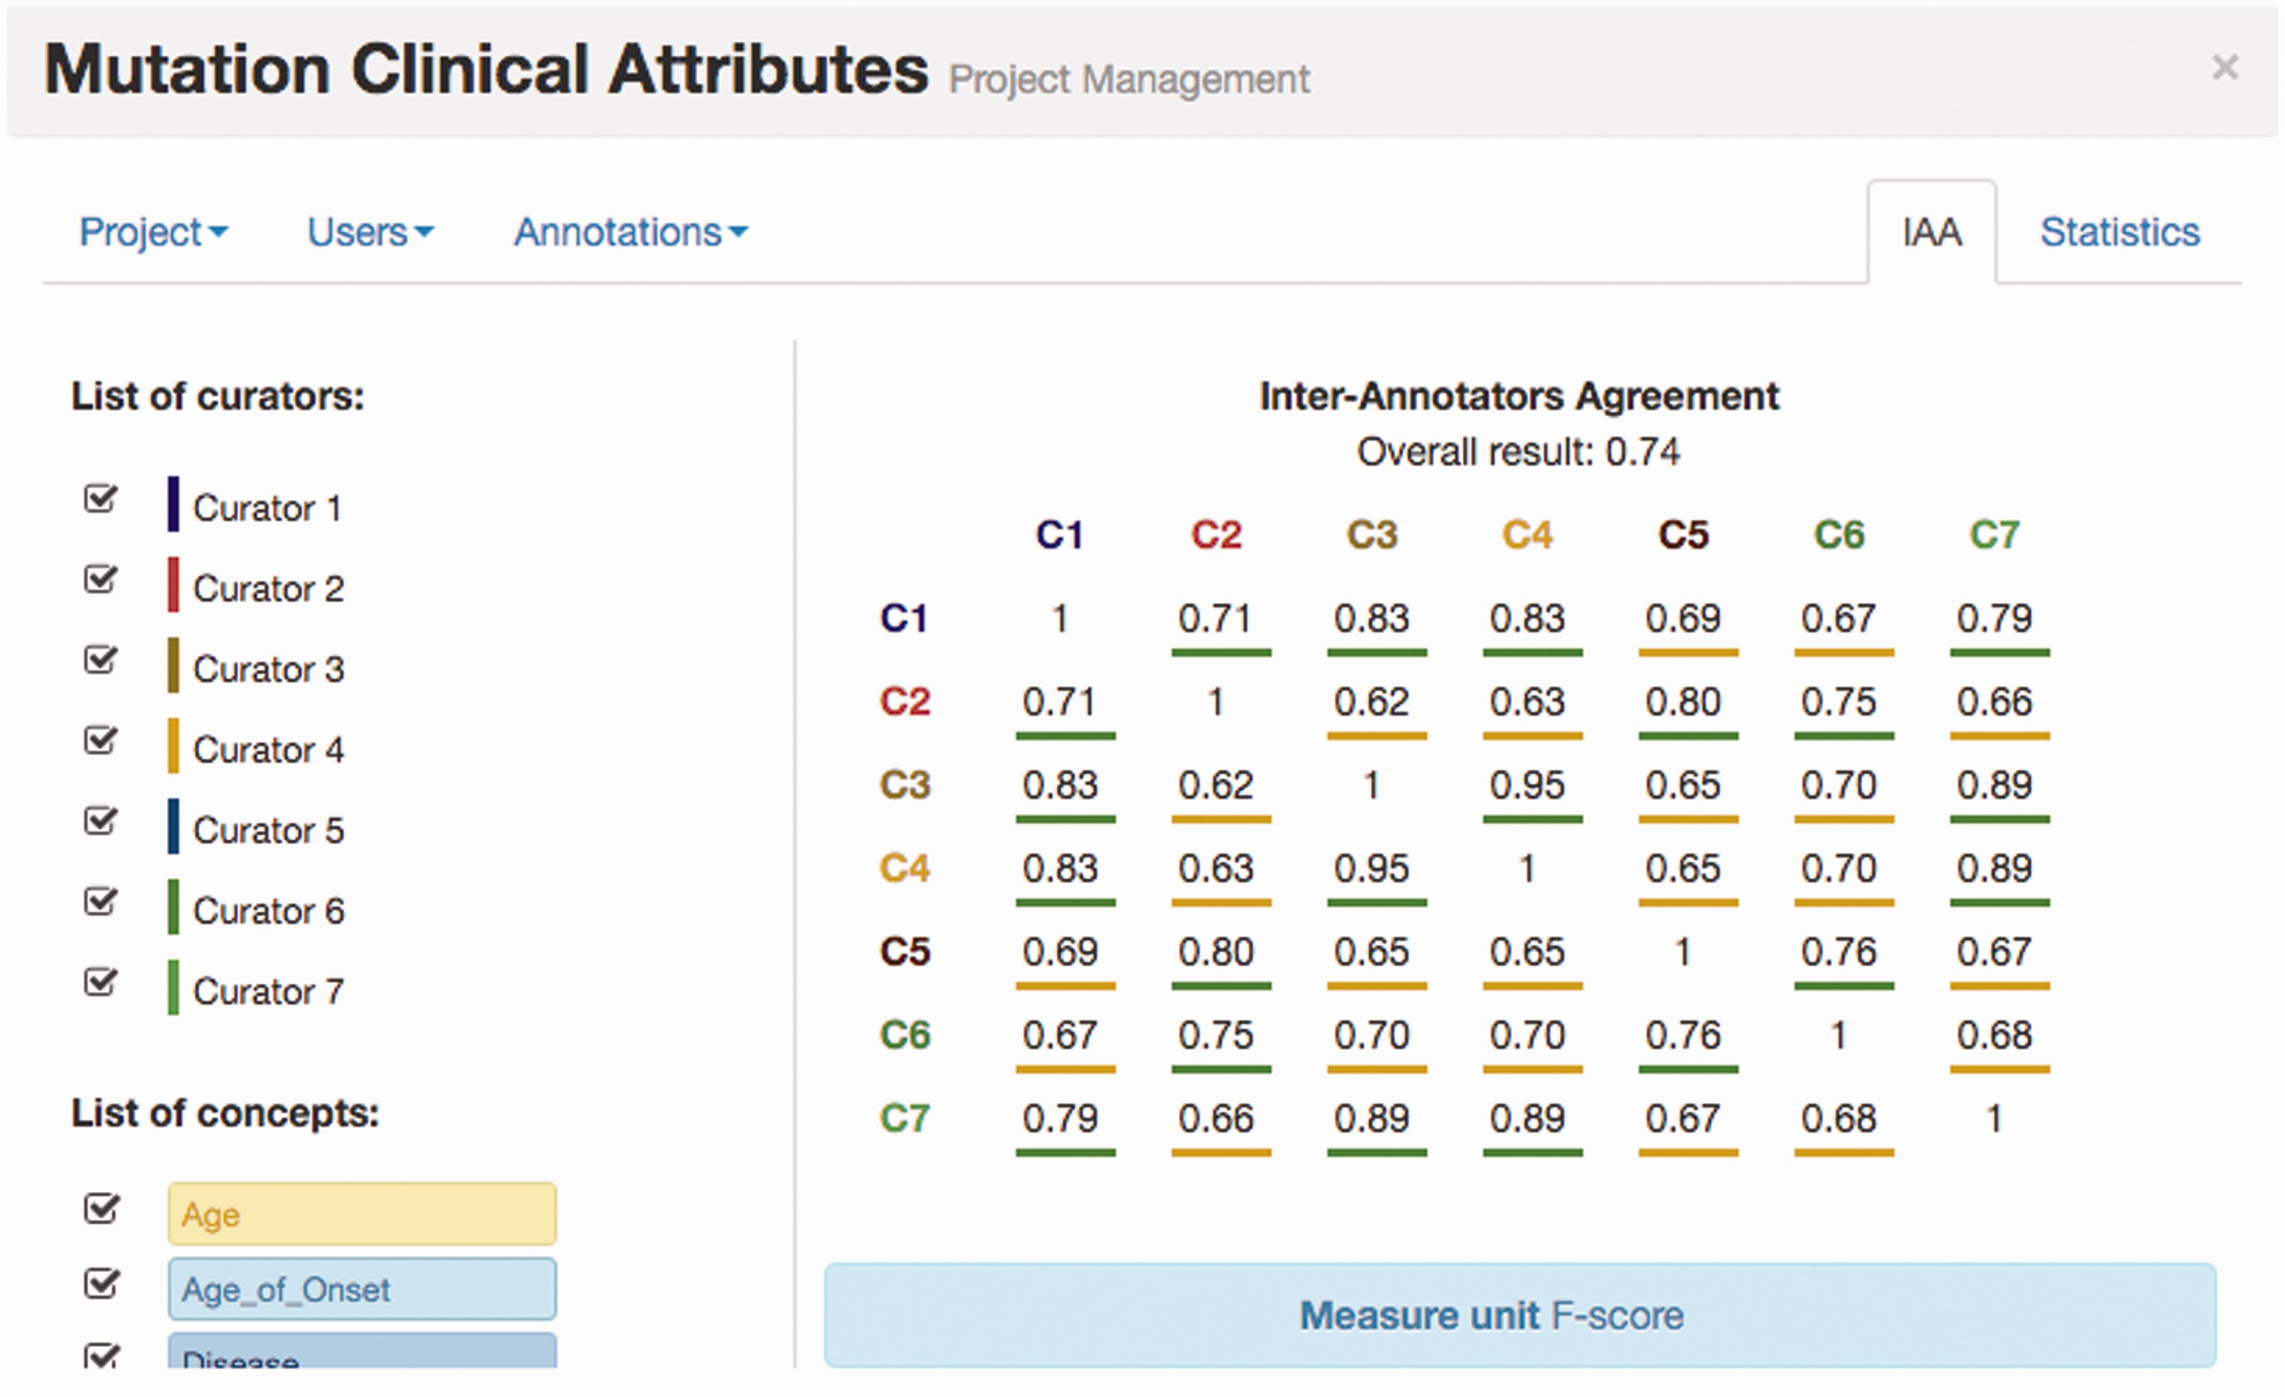
Figure 4. IAA panel in Egas. The IAA is calculated as the F -score between each pair of curators, and the average of ...
Notes:
Figure 4. IAA panel in Egas. The IAA is calculated as the F -score between each pair of curators, and the average of these values is taken as the overall result. Annotations for each concept type and each curator can be included or removed from the calculation by using the checkboxes on the left.
Unless provided in the caption above, the following copyright applies to the content of this slide: © The Author(s) 2016. Published by Oxford University Press. This is an Open Access article distributed under the terms of the Creative Commons Attribution License ( http://creativecommons.org/licenses/by/4.0/ ), which permits unrestricted reuse, distribution, and reproduction in any medium, provided the original work is properly cited.

Slide 5
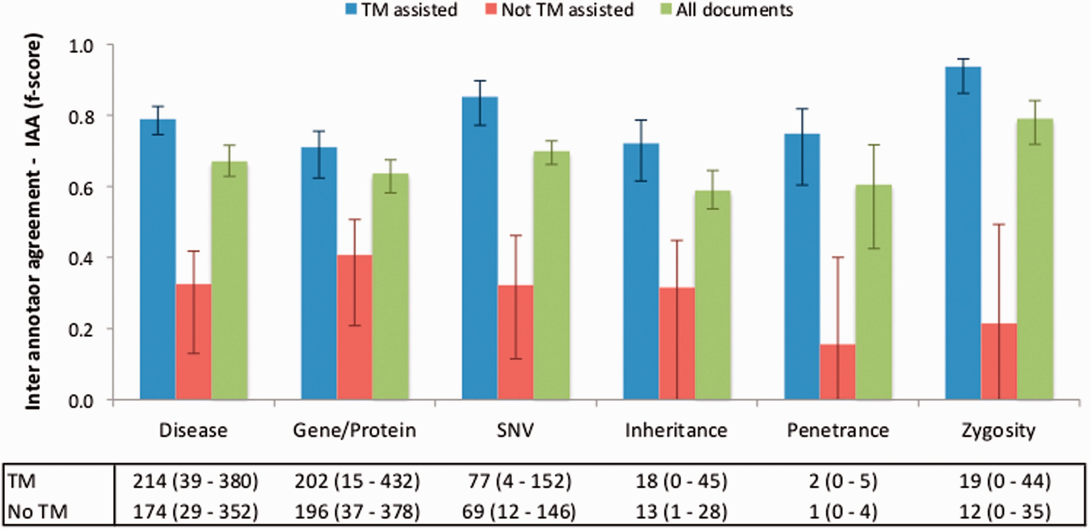
Figure 5. IAA obtained on documents pre-annotated with automated TM services, without pre-annotation, and on all ...
Notes:
Figure 5. IAA obtained on documents pre-annotated with automated TM services, without pre-annotation, and on all documents. The error lines show the minimum and maximum IAA values for all pairs of annotators. The data table shows the average (range) number of annotations for each concept type using TM-assisted vs. not TM-assisted curation.
Unless provided in the caption above, the following copyright applies to the content of this slide: © The Author(s) 2016. Published by Oxford University Press. This is an Open Access article distributed under the terms of the Creative Commons Attribution License ( http://creativecommons.org/licenses/by/4.0/ ), which permits unrestricted reuse, distribution, and reproduction in any medium, provided the original work is properly cited.

Slide 6
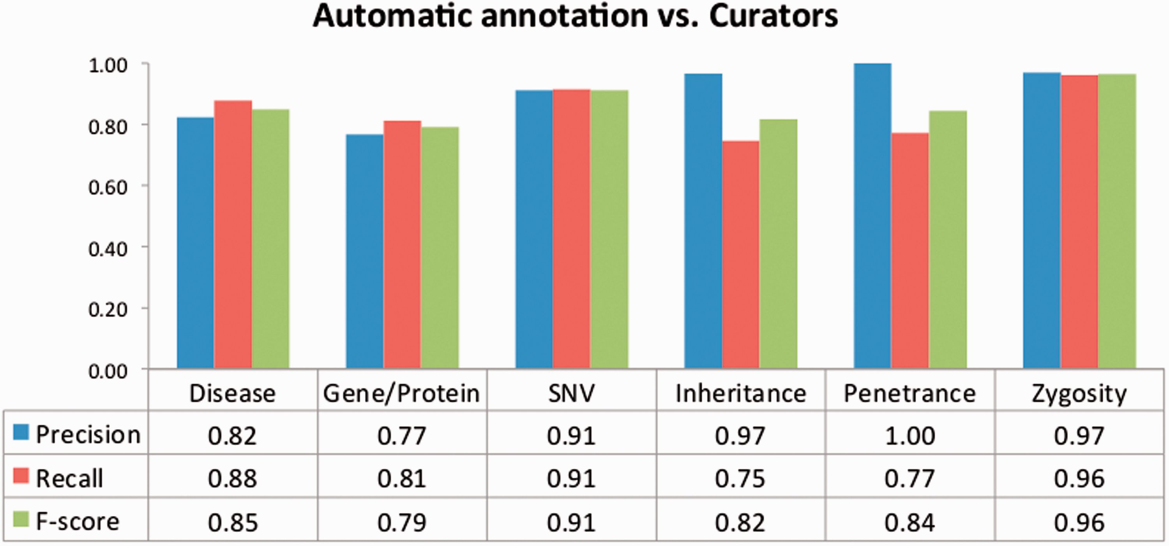
Figure 6. Evaluation of the automatic annotations provided in the corpus. The data table shows the average precision, ...
Notes:
Figure 6. Evaluation of the automatic annotations provided in the corpus. The data table shows the average precision, recall and F -score against all curators.
Unless provided in the caption above, the following copyright applies to the content of this slide: © The Author(s) 2016. Published by Oxford University Press. This is an Open Access article distributed under the terms of the Creative Commons Attribution License ( http://creativecommons.org/licenses/by/4.0/ ), which permits unrestricted reuse, distribution, and reproduction in any medium, provided the original work is properly cited.

