Slide 1
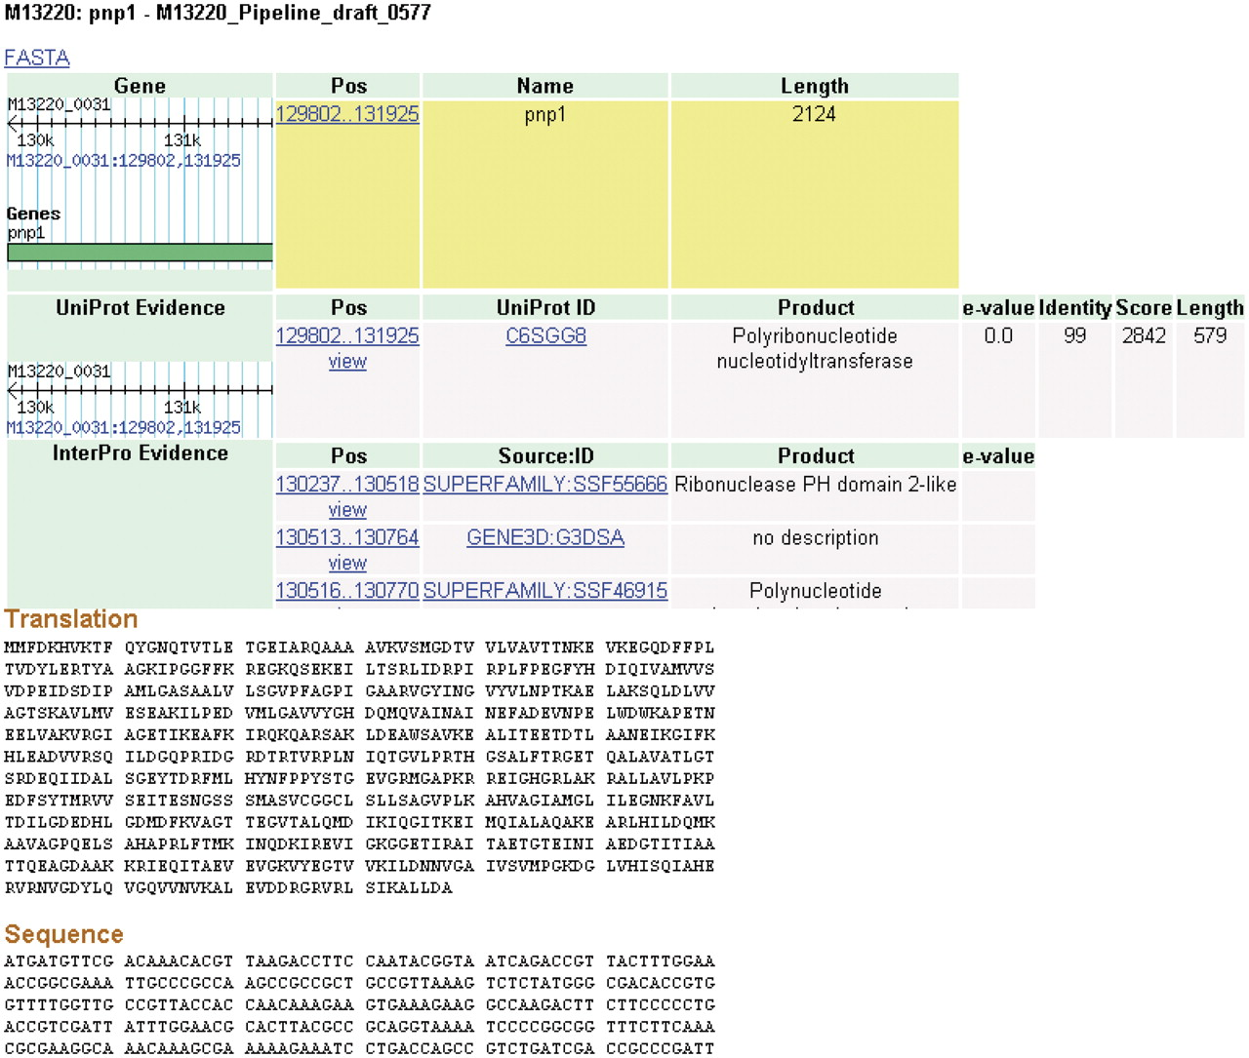
Figure 4. Details page. The details for some features of a coding sequence are shown. Up to five overlapping feature ...
Notes:
Figure 4. Details page. The details for some features of a coding sequence are shown. Up to five overlapping feature types may appear: gene, protein, protein domain, signal peptide and transmembrane structure. The target feature is highlighted in yellow. The nucleotide and amino acid sequences for this feature appear at the bottom of the page. All features on the page include links to their coordinates in GBrowse genome viewer.
Unless provided in the caption above, the following copyright applies to the content of this slide: © The Author(s) 2011. Published by Oxford University Press.This is Open Access article distributed under the terms of the Creative Commons Attribution Non-Commercial License (http://creativecommons.org/licenses/by-nc/2.5), which permits unrestricted non-commercial use, distribution, and reproduction in any medium, provided the original work is properly cited.

