Slide 1
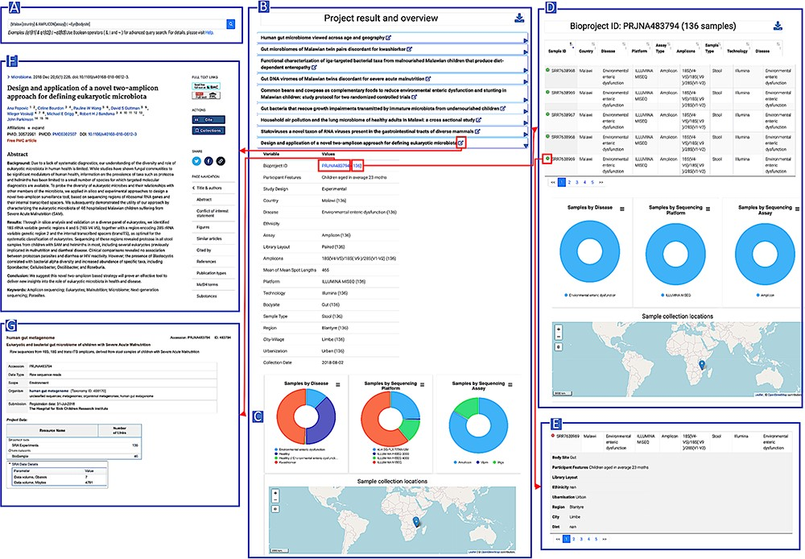
Figure 3. AHMP functionalities: Results can be queried using the search bar on the Home page (A). Example of query ...
Notes:
Figure 3. AHMP functionalities: Results can be queried using the search bar on the Home page (A). Example of query results: All the bioprojects related to the query keywords are displayed (B) and results can be further filtered using the interactive charts (D). Minimal information by project (C) or more extended description of samples (E) is also available. A hyperlink to the corresponding publications (F) and the original data (G) is available. Alt text Figure 3: African Microbiome Database Portal user interface snapshots.
Unless provided in the caption above, the following copyright applies to the content of this slide: © The Author(s) 2024. Published by Oxford University Press.This is an Open Access article distributed under the terms of the Creative Commons Attribution License (https://creativecommons.org/licenses/by/4.0/), which permits unrestricted reuse, distribution, and reproduction in any medium, provided the original work is properly cited.

