Slide 1
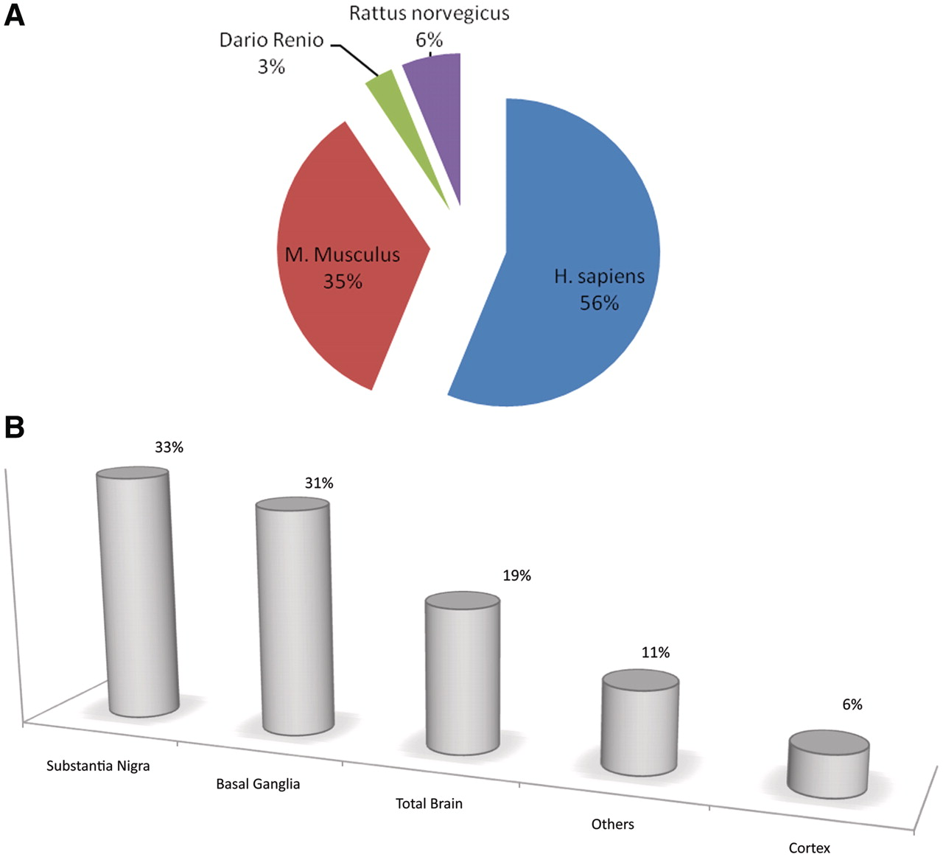
Figure 2. Pie charts and bar plot representing the curated information for each biological tissue, organism and ...
Notes:
Figure 2. Pie charts and bar plot representing the curated information for each biological tissue, organism and comparison. Fifty-six percent of resources are retrieved from human experiments, 35% from mouse, 6% from rat and the remaining 3% from zebrafish. (A). Thirty-three percent of the tissues included in ParkDB were obtained from substantia nigra, 31% from basal ganglia, 19% from the whole brain, 6% from different regions of cortex and 11% from different tissues such as Blood, B Lymphocytes, etc. (B).
Unless provided in the caption above, the following copyright applies to the content of this slide: © The Author(s) 2011. Published by Oxford University Press.This is Open Access article distributed under the terms of the Creative Commons Attribution Non-Commercial License (http://creativecommons.org/licenses/by-nc/2.5), which permits unrestricted non-commercial use, distribution, and reproduction in any medium, provided the original work is properly cited.

