Slide 1
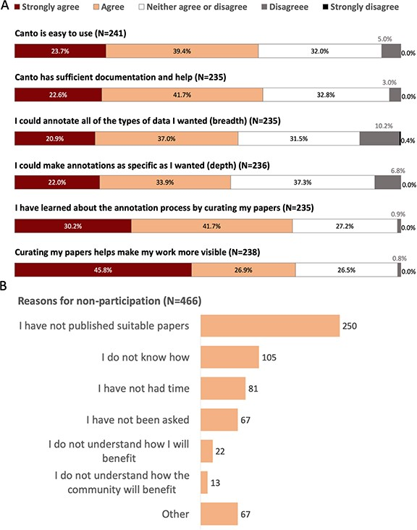
Figure 3 Community perception of Canto curation from 2019 PomBase user survey. A. Responses to questions evaluating ...
Notes:
Figure 3 Community perception of Canto curation from 2019 PomBase user survey. A. Responses to questions evaluating Canto usability. Note: 30% of respondents (189/632) reported having used Canto. B. Reasons given for not participating in community curation. Free text responses from respondents selecting ‘other’ indicate that many intend to participate in the future, or found that their papers had already been curated by other lab members.
Unless provided in the caption above, the following copyright applies to the content of this slide: © The Author(s) 2020. Published by Oxford University Press.This is an Open Access article distributed under the terms of the Creative Commons Attribution License (http://creativecommons.org/licenses/by/4.0/), which permits unrestricted reuse, distribution, and reproduction in any medium, provided the original work is properly cited.

