Slide 1
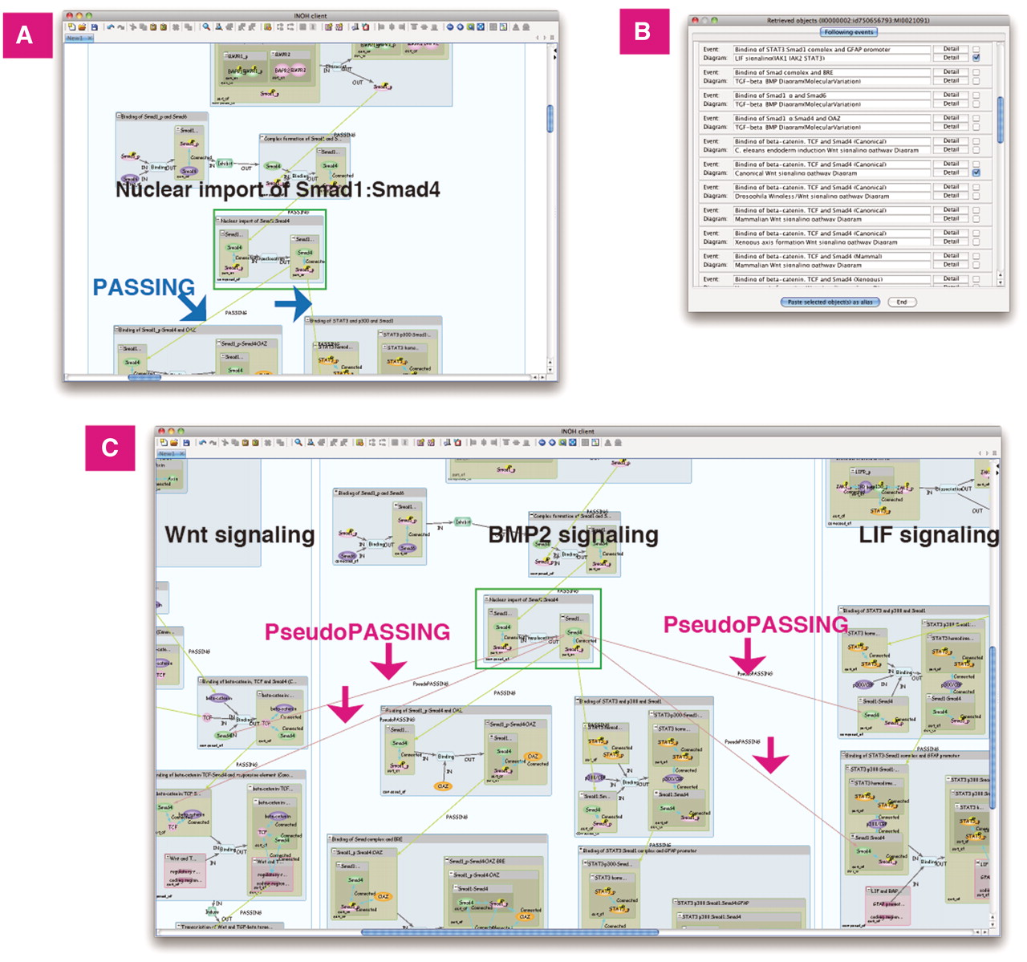
Figure 5. Previous/following event search. BMP2 signaling does ‘cross-talk’ with Wnt and LIF signaling. (A) Search ...
Notes:
Figure 5. Previous/following event search. BMP2 signaling does ‘cross-talk’ with Wnt and LIF signaling. (A) Search following events of ‘Nuclear import of Smad1:Smad4’ in BMP2 signaling. The curated following events are connected to the event by the PASSING edges. (B) List of following events and its diagram. (C) Wnt and LIF signaling is pasted on same canvas. The inferred following events are connected by the PseudoPASSING edges.
Unless provided in the caption above, the following copyright applies to the content of this slide: © The Author(s) 2011. Published by Oxford University Press.This is an Open Access article distributed under the terms of the Creative Commons Attribution Non-Commercial License (http://creativecommons.org/licenses/by-nc/3.0), which permits unrestricted non-commercial use, distribution, and reproduction in any medium, provided the original work is properly cited.

