Slide 1
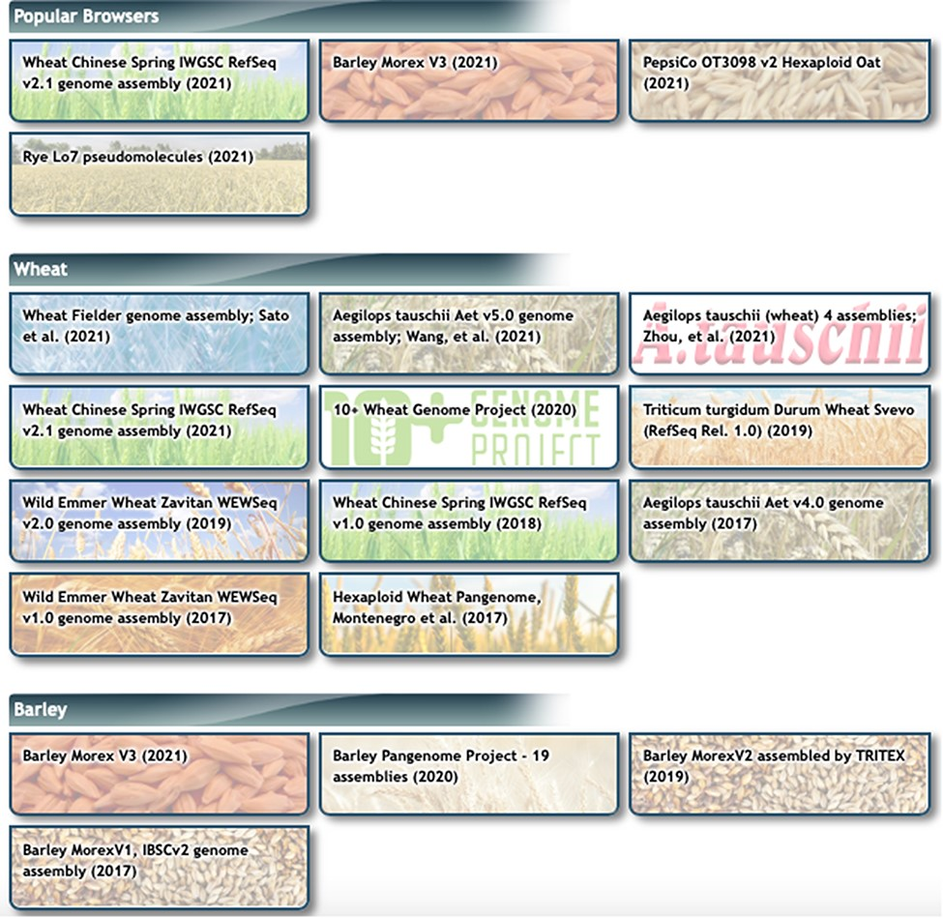
Figure 2. Genome Browsers page at GrainGenes. Note that the 10+ Wheat Genome Project and Barley PanGenome Project ...
Notes:
Figure 2. Genome Browsers page at GrainGenes. Note that the 10+ Wheat Genome Project and Barley PanGenome Project buttons open up multiple single-assembly browsers.
Unless provided in the caption above, the following copyright applies to the content of this slide: © Her Majesty the Queen in Right of Canada, as represented by the Minister of Agriculture and Agri-Food Canada, 2022. Elements of this work were written by an US Government Employee and the work is public domain in the US. Published by Oxford University Press 2022.This work is written by (a) US Government employee(s) and is in the public domain in the US.

