Slide 1
Figure 1. A scheme of the database structure. There is the main table connected to five metadata tables. * marks ...
Notes:
Figure 1. A scheme of the database structure. There is the main table connected to five metadata tables. * marks mandatory variables. Examples of trait categories are given on the right. Photos: S. Pekár.
Unless provided in the caption above, the following copyright applies to the content of this slide: © The Author(s) 2021. Published by Oxford University Press.This is an Open Access article distributed under the terms of the Creative Commons Attribution License (https://creativecommons.org/licenses/by/4.0/), which permits unrestricted reuse, distribution, and reproduction in any medium, provided the original work is properly cited.

Slide 2
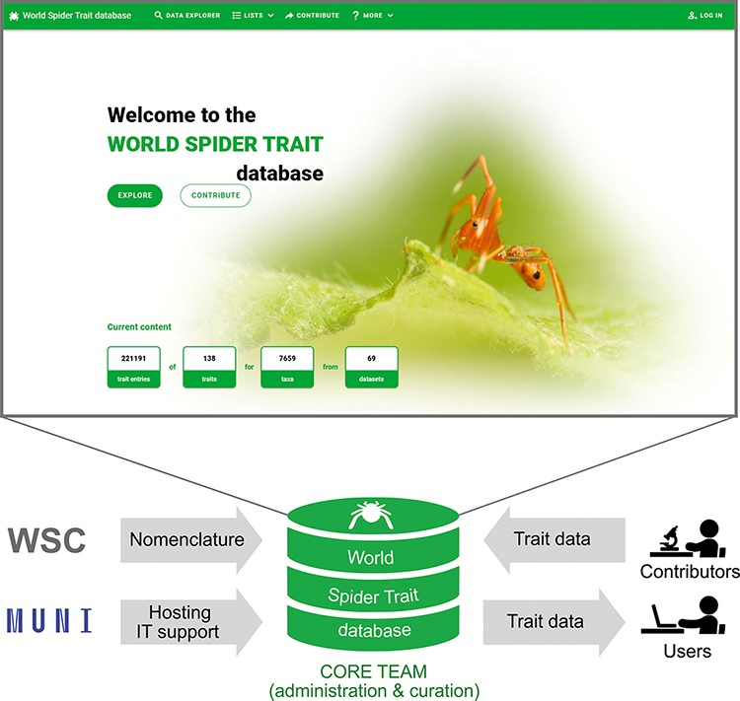
Figure 2. The scheme of the World Spider Trait database application, depicting the role of contributing bodies and the ...
Notes:
Figure 2. The scheme of the World Spider Trait database application, depicting the role of contributing bodies and the frontpage of the webpage (https://spidertraits.sci.muni.cz/, accessed on 5 March 2021). WSC stands for World Spider Catalog, MUNI stands for Masaryk University.
Unless provided in the caption above, the following copyright applies to the content of this slide: © The Author(s) 2021. Published by Oxford University Press.This is an Open Access article distributed under the terms of the Creative Commons Attribution License (https://creativecommons.org/licenses/by/4.0/), which permits unrestricted reuse, distribution, and reproduction in any medium, provided the original work is properly cited.

Slide 3
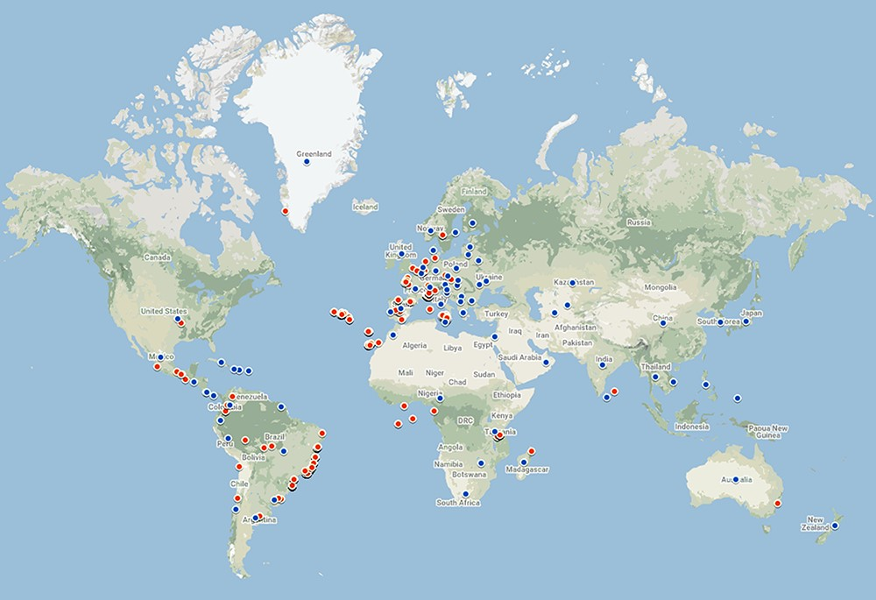
Figure 3. Geographic coverage of the data currently in the database. Red points represent geo-referenced records, while ...
Notes:
Figure 3. Geographic coverage of the data currently in the database. Red points represent geo-referenced records, while blue points are country centroids (for records that do not have an exact geographical reference). There are records from 70 countries and 479 locations. The map was created using Google Maps.
Unless provided in the caption above, the following copyright applies to the content of this slide: © The Author(s) 2021. Published by Oxford University Press.This is an Open Access article distributed under the terms of the Creative Commons Attribution License (https://creativecommons.org/licenses/by/4.0/), which permits unrestricted reuse, distribution, and reproduction in any medium, provided the original work is properly cited.

Slide 4
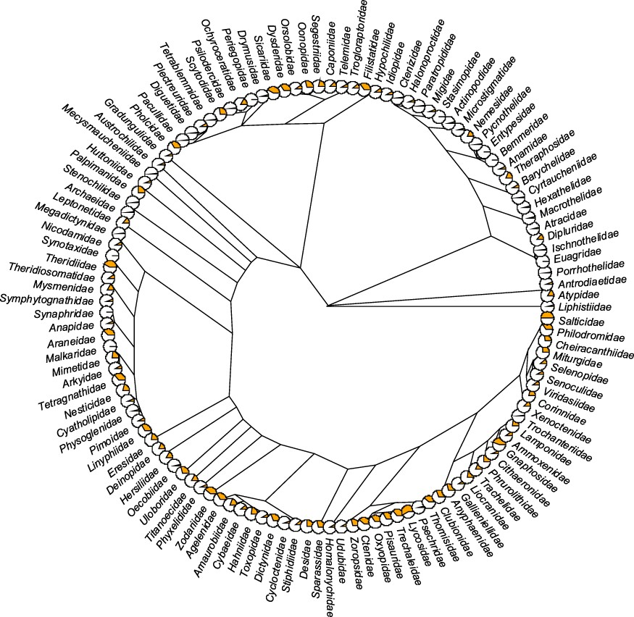
Figure 4. Trait coverage mapped on the tree. The tree is on the family level (composed of 121 families) with the ...
Notes:
Figure 4. Trait coverage mapped on the tree. The tree is on the family level (composed of 121 families) with the proportion of the total number of traits (orange) displayed as pie charts (the fuller the pie, the more the traits). The tree was constructed based on the recent phylogeny of spiders (42). Five families (Hexurellidae, Mecicobothriidae, Megahexuridae, Microhexuridae and Myrmecicultoridae) were omitted because their position in the tree is not known.
Unless provided in the caption above, the following copyright applies to the content of this slide: © The Author(s) 2021. Published by Oxford University Press.This is an Open Access article distributed under the terms of the Creative Commons Attribution License (https://creativecommons.org/licenses/by/4.0/), which permits unrestricted reuse, distribution, and reproduction in any medium, provided the original work is properly cited.

Slide 5
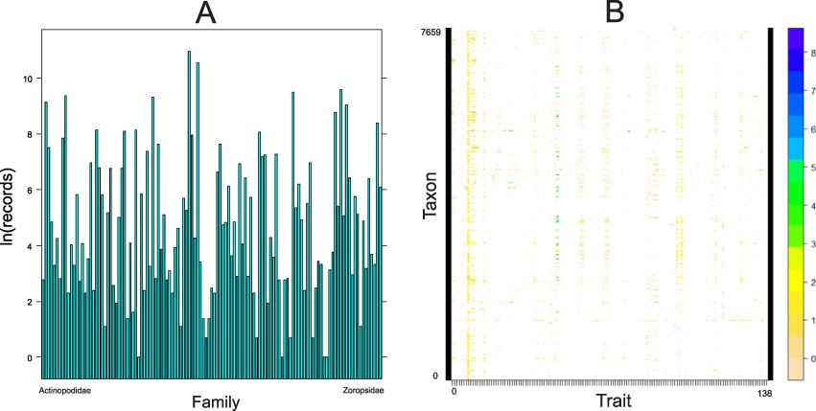
Figure 5. Quantitative content of the database. A. Number of records (logarithmically transformed) for each family ...
Notes:
Figure 5. Quantitative content of the database. A. Number of records (logarithmically transformed) for each family included in the database, arranged alphabetically. B. The taxon by trait matrix representing the completeness. The most complete traits include body length (64% of taxa), followed by cephalothorax length (23%) and cephalothorax width (19%). Dots represent logarithmically transformed number of records per taxon. Taxon includes one of the following: subspecies, species, genus or family.
Unless provided in the caption above, the following copyright applies to the content of this slide: © The Author(s) 2021. Published by Oxford University Press.This is an Open Access article distributed under the terms of the Creative Commons Attribution License (https://creativecommons.org/licenses/by/4.0/), which permits unrestricted reuse, distribution, and reproduction in any medium, provided the original work is properly cited.

