Slide 1
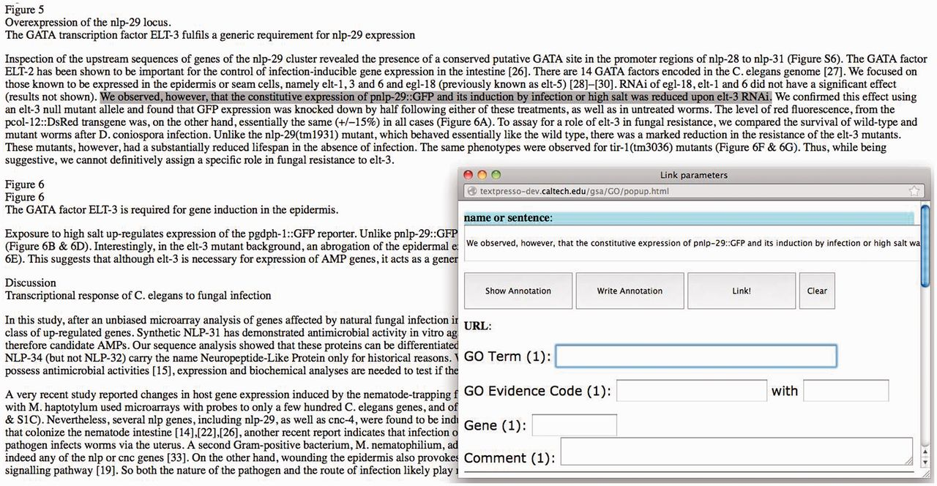
Figure 1. Screenshot of the GO annotation tool. When a line or more of text is highlighted, a pop-up window appears ...
Notes:
Figure 1. Screenshot of the GO annotation tool. When a line or more of text is highlighted, a pop-up window appears where annotation data are entered.
Unless provided in the caption above, the following copyright applies to the content of this slide: Published by Oxford University Press 2014. This work is written by US Government employees and is in the public domain in the US.

