Slide 1
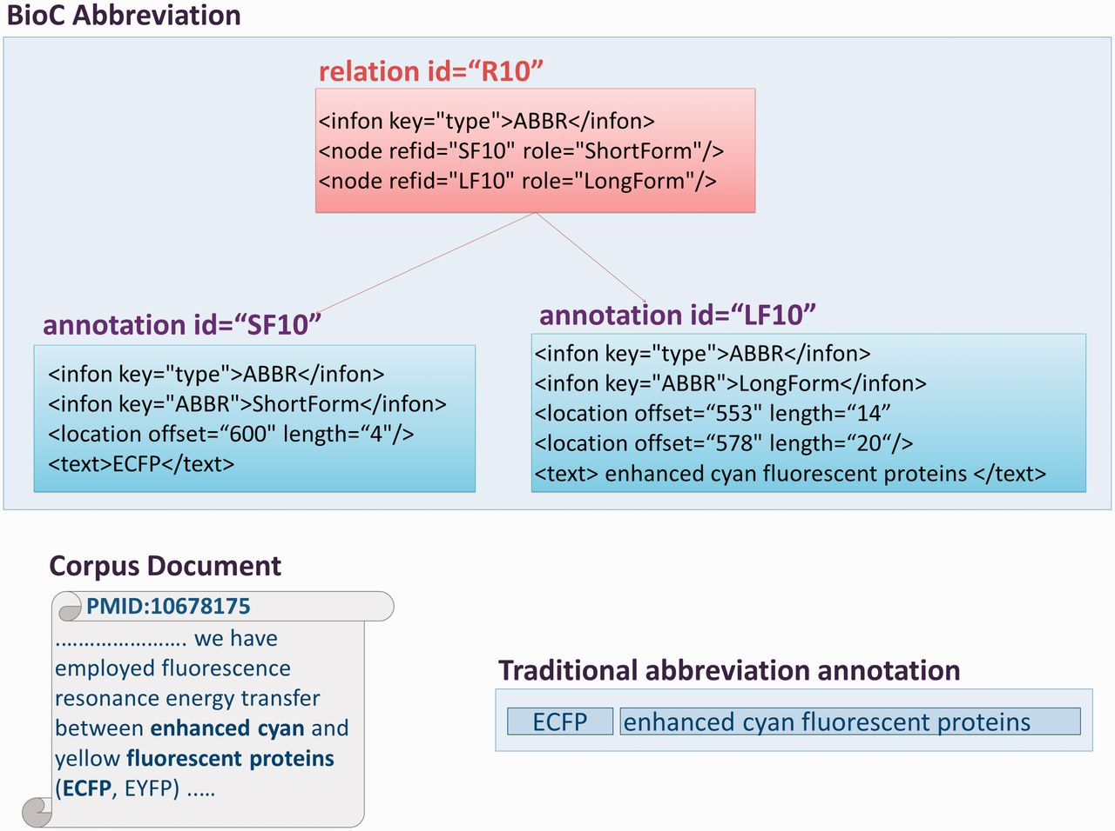
Figure 2 A graphical representation of abbreviation annotations in BioC format. The excerpt from one of the corpus ...
Notes:
Figure 2 A graphical representation of abbreviation annotations in BioC format. The excerpt from one of the corpus documents contains multi-segmented abbreviation long forms. The traditional ShortForm, LongForm pairing is shown in the figure, as well as the infons detailing BioC annotations for an abbreviation, and the relation between them, with the corresponding precise text offsets.
Unless provided in the caption above, the following copyright applies to the content of this slide: Published by Oxford University Press 2014. This work is written by US Government employees and is in the public domain in the US.

