Slide 1
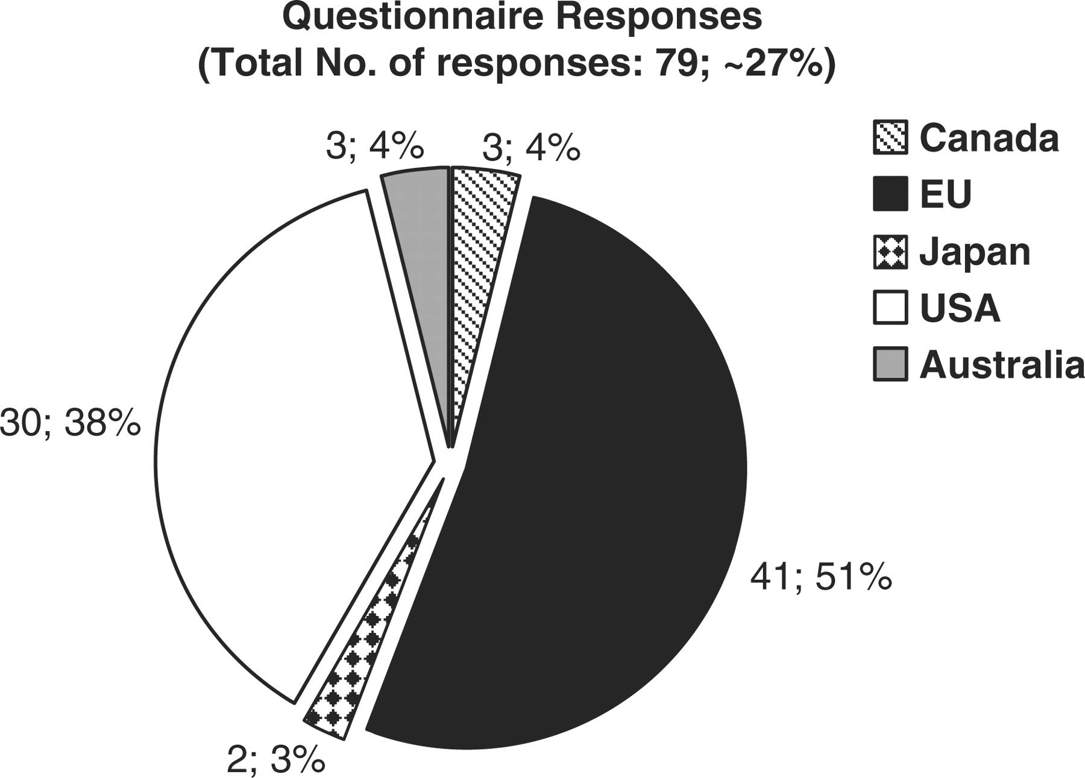
Figure 2. Graph representing the origin of each biological database or resource that responded to the online ...
Notes:
Figure 2. Graph representing the origin of each biological database or resource that responded to the online questionnaire. 51 percent of resources are in Europe, 38% in the USA, 4% in Australia and Canada, and 3% in Japan.
Unless provided in the caption above, the following copyright applies to the content of this slide: © The Author(s) 2009. Published by Oxford University Press.This is Open Access article distributed under the terms of the Creative Commons Attribution Non-Commercial License (http://creativecommons.org/licenses/by-nc/2.5/uk/) which permits unrestricted non-commercial use, distribution, and reproduction in any medium, provided the original work is properly cited.

