Slide 1
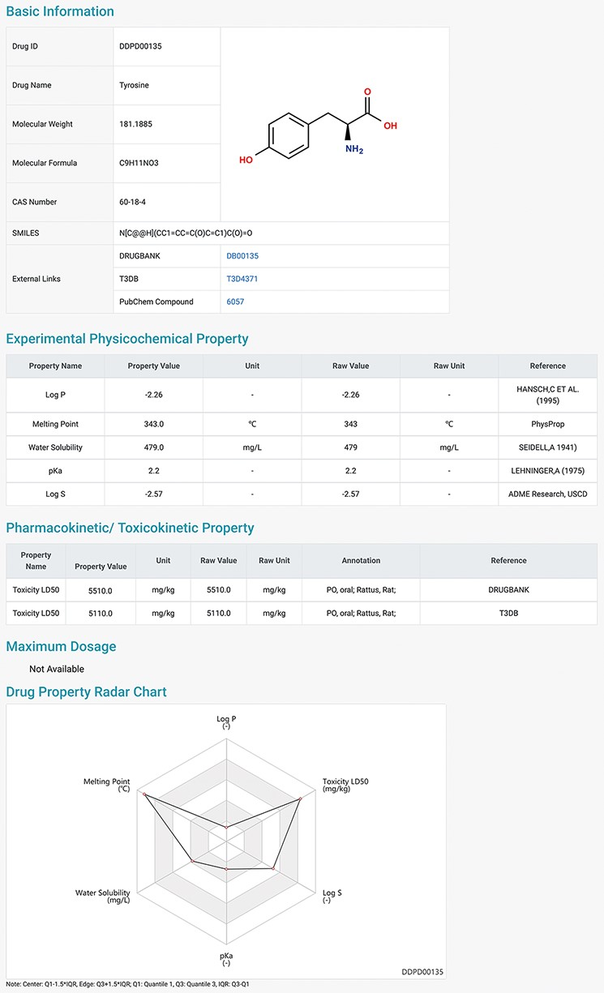
Figure 2. Detailed information page of a drug example. Users can view detailed information of the selected drug, ...
Notes:
Figure 2. Detailed information page of a drug example. Users can view detailed information of the selected drug, including basic information, physicochemical properties, pharmacokinetic and toxicokinetic properties, as well as maximum dosages. A radar chart which displays the values of all the properties of the selected drug is shown at the bottom.
Unless provided in the caption above, the following copyright applies to the content of this slide: © The Author(s) 2022. Published by Oxford University Press.This is an Open Access article distributed under the terms of the Creative Commons Attribution License (https://creativecommons.org/licenses/by/4.0/), which permits unrestricted reuse, distribution, and reproduction in any medium, provided the original work is properly cited.

