Slide 1
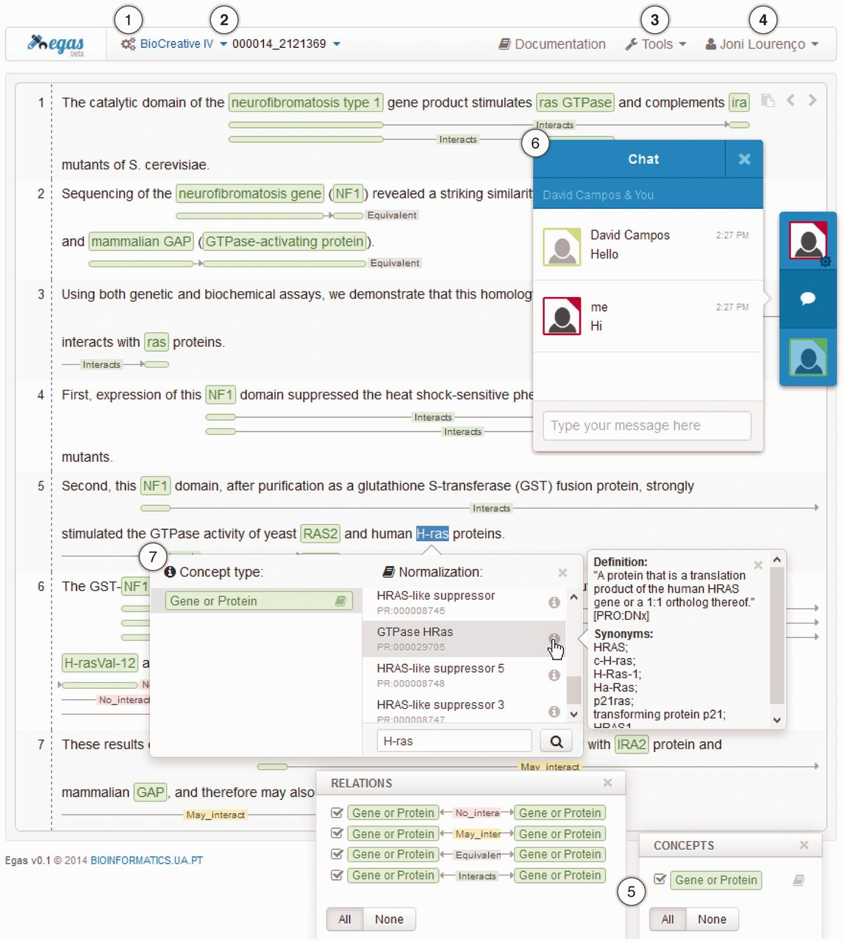
Figure 3. Egas main interface presenting a PubMed abstract (PMID 2121369) with annotated concepts and relations and ...
Notes:
Figure 3. Egas main interface presenting a PubMed abstract (PMID 2121369) with annotated concepts and relations and emphasizing relevant interaction components/features: (1) project management; (2) project and document navigators; (3) processing tools; (4) account management; (5) concept and relation type visualization filters; (6) real-time collaboration; and, (7) concept annotation with normalization.
Unless provided in the caption above, the following copyright applies to the content of this slide: © The Author(s) 2014. Published by Oxford University Press.This is an Open Access article distributed under the terms of the Creative Commons Attribution License (http://creativecommons.org/licenses/by/3.0/), which permits unrestricted reuse, distribution, and reproduction in any medium, provided the original work is properly cited.

