Slide 1
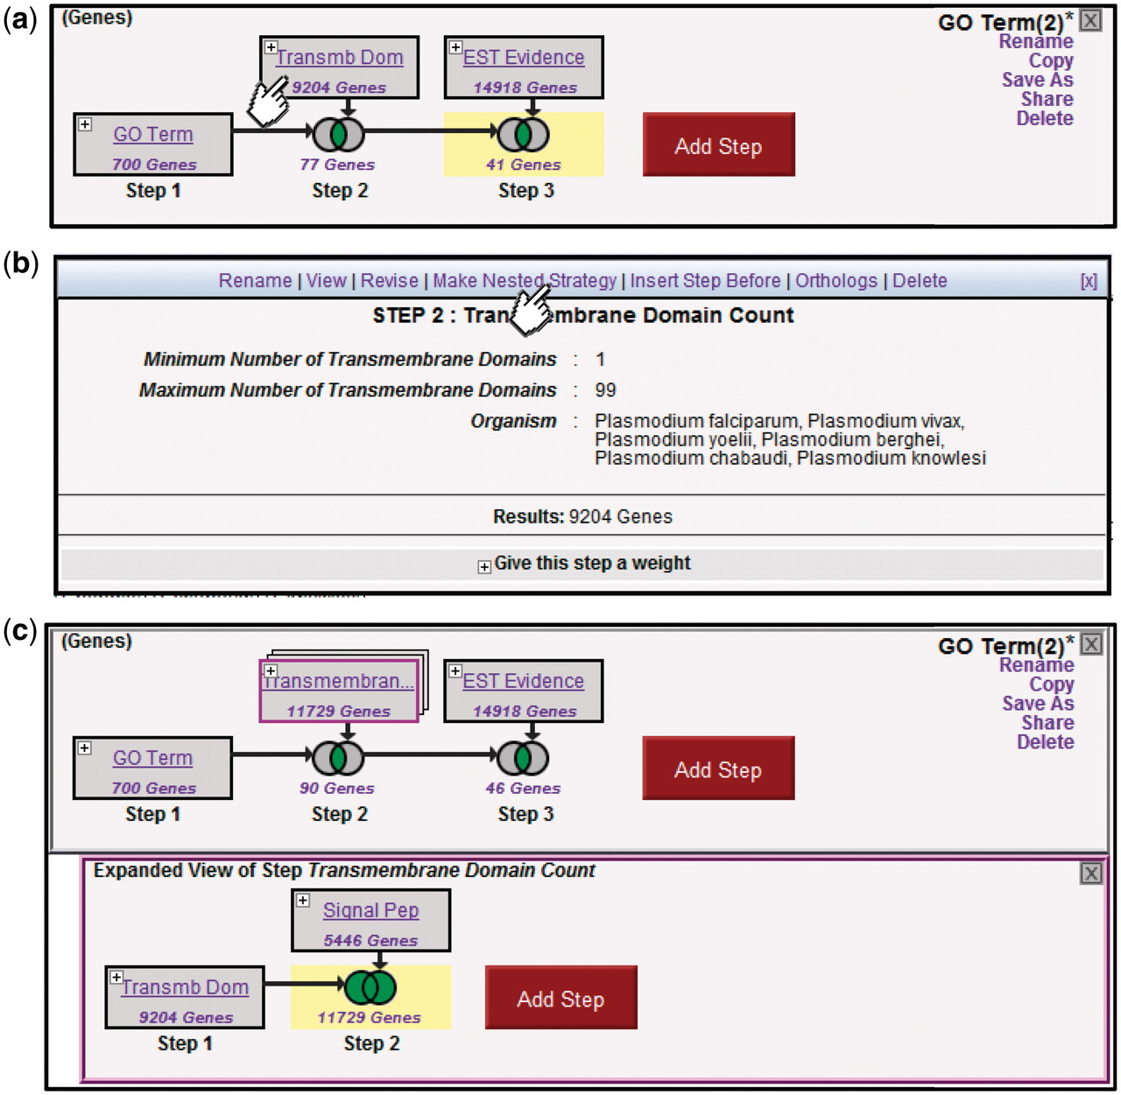
Figure 4. Creating nested Strategies. Clicking on the + icon in Step 2 of the three-step strategy shown (a) brings up a ...
Notes:
Figure 4. Creating nested Strategies. Clicking on the + icon in Step 2 of the three-step strategy shown (a) brings up a menu displaying the details of this step (b), and a set of available actions (Rename, View, Revise, Make Nested Strategy, Insert Step Before, Orthologs, Delete). Clicking on Make Nested Strategy expands the step into its own panel (c), where the user can add additional steps that become nested within the second step in the top panel (TB domain and/or signal peptide in the example shown).
Unless provided in the caption above, the following copyright applies to the content of this slide: © The Author(s) 2011. Published by Oxford University Press.This is Open Access article distributed under the terms of the Creative Commons Attribution Non-Commercial License (http://creativecommons.org/licenses/by-nc/2.5), which permits unrestricted non-commercial use, distribution, and reproduction in any medium, provided the original work is properly cited.

