Slide 1
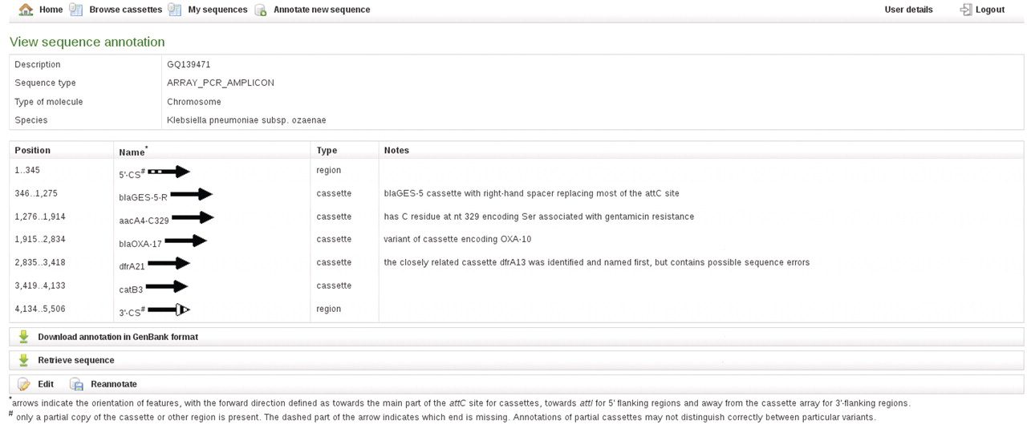
Figure 3. RAC annotation of an exemplar cassette array, including examples of partial features, a bla variant cassette, ...
Notes:
Figure 3. RAC annotation of an exemplar cassette array, including examples of partial features, a bla variant cassette, an aacA4 cassette and the type of additional information given in Notes.
Unless provided in the caption above, the following copyright applies to the content of this slide: © The Author(s) 2011. Published by Oxford University Press.This is an Open Access article distributed under the terms of the Creative Commons Attribution Non-Commercial License (http://creativecommons.org/licenses/by-nc/3.0), which permits unrestricted non-commercial use, distribution, and reproduction in any medium, provided the original work is properly cited.

