Slide 1
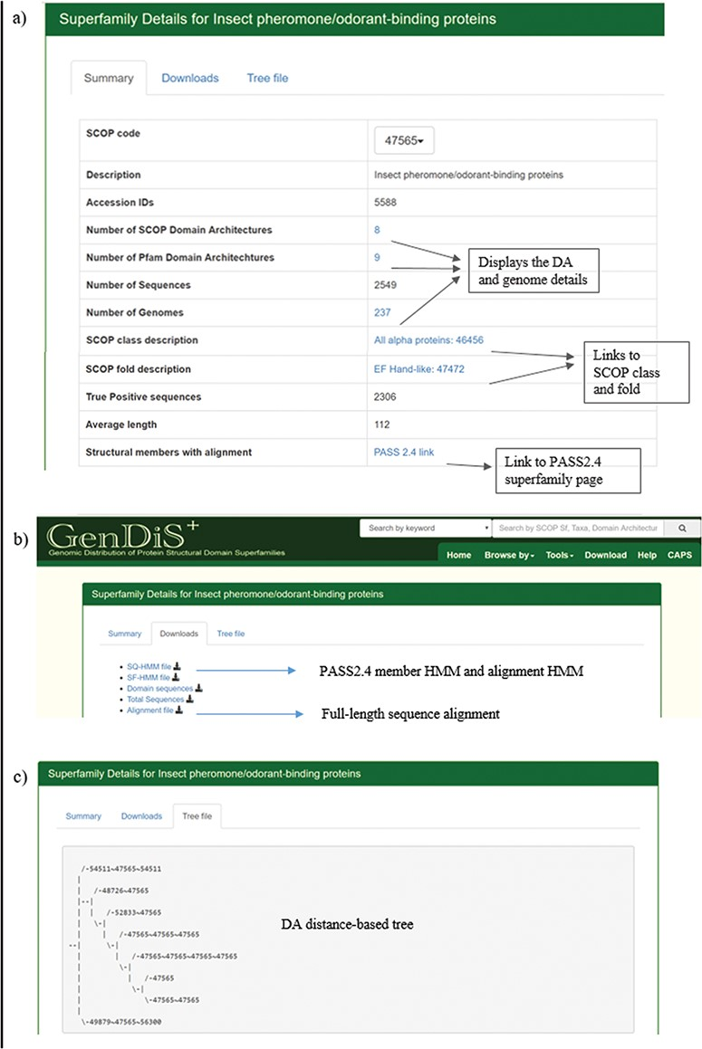
Figure 4 Superfamily description page. Details pertaining to each superfamily like (a) SCOP/Pfam DA, genomes covered, ...
Notes:
Figure 4 Superfamily description page. Details pertaining to each superfamily like (a) SCOP/Pfam DA, genomes covered, full length are available in the summary page; (b) validated sequences, domain sequence alignment and phylogeny are available for download in the `Downloads’ page; and (c) the DA-distance trees can be visualized in the `Tree file’ page.
Unless provided in the caption above, the following copyright applies to the content of this slide: © The Author(s) 2019. Published by Oxford University Press.This is an Open Access article distributed under the terms of the Creative Commons Attribution License (http://creativecommons.org/licenses/by/4.0/), which permits unrestricted reuse, distribution, and reproduction in any medium, provided the original work is properly cited.

