Slide 1
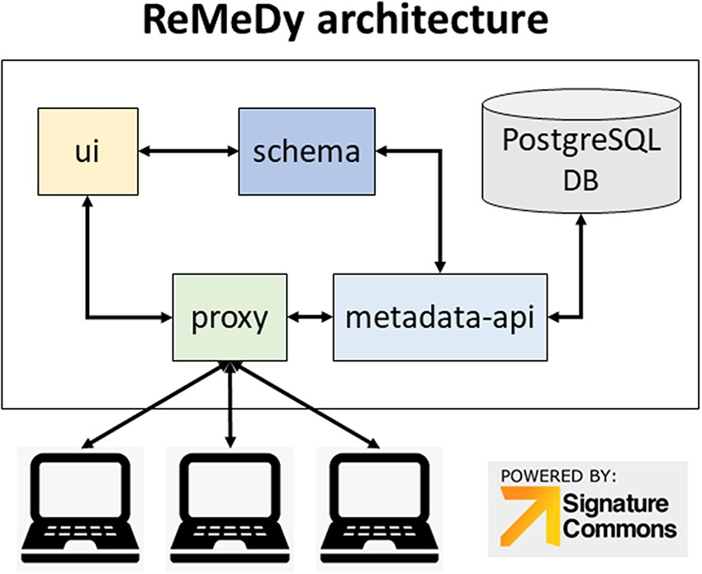
Figure 1. ReMeDy platform architecture that is based on an implementation of the NIH BD2K-LINCS DDCIC developed ...
Notes:
Figure 1. ReMeDy platform architecture that is based on an implementation of the NIH BD2K-LINCS DDCIC developed Signature Commons platform, installed through Docker. The figure illustrates the interaction between the Docker packages and the PostgreSQL database.
Unless provided in the caption above, the following copyright applies to the content of this slide: © The Author(s) 2021. Published by Oxford University Press.This is an Open Access article distributed under the terms of the Creative Commons Attribution License (http://creativecommons.org/licenses/by/4.0/), which permits unrestricted reuse, distribution, and reproduction in any medium, provided the original work is properly cited.

