Slide 1
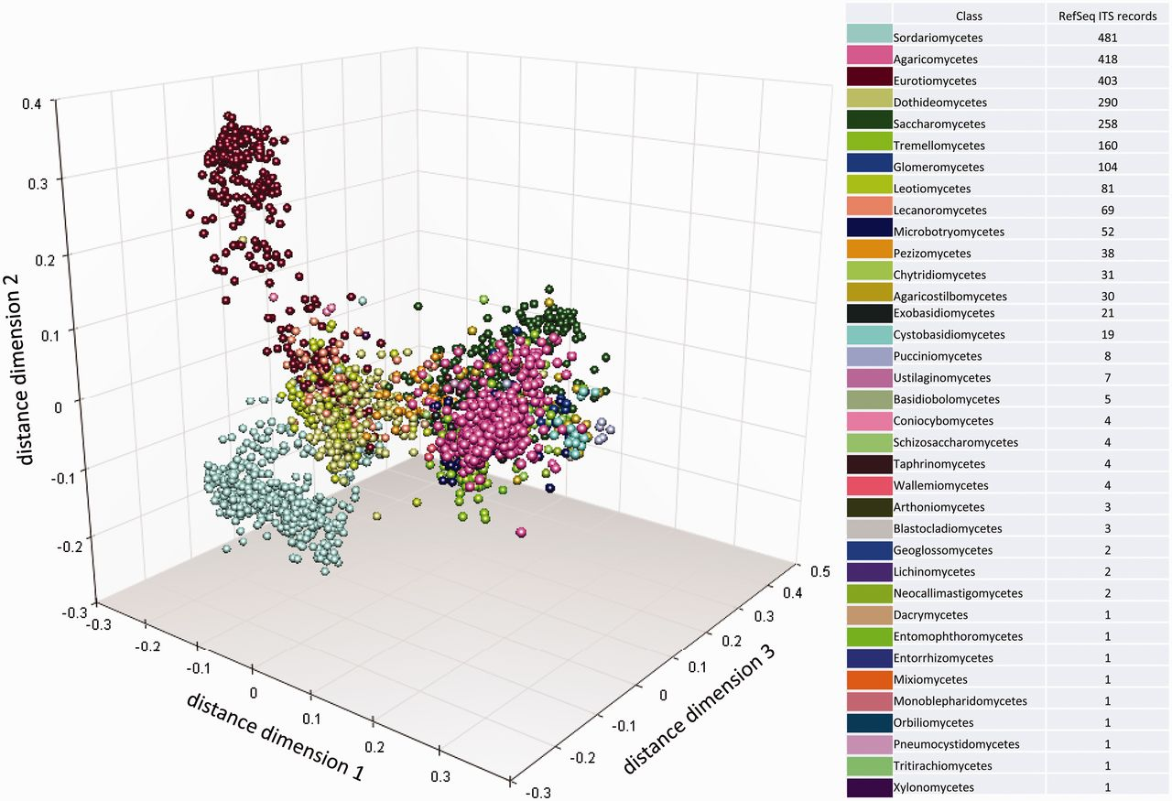
Figure 6. Multidimensional scaling clustering of RTL ITS sequences and coloring, according to the NCBI Taxonomy ...
Notes:
Figure 6. Multidimensional scaling clustering of RTL ITS sequences and coloring, according to the NCBI Taxonomy classification at class rank. Each marker represents an individual sequence.
Unless provided in the caption above, the following copyright applies to the content of this slide: Published by Oxford University Press 2013. This work is written by US Government employees and is in the public domain in the US.

