Slide 1
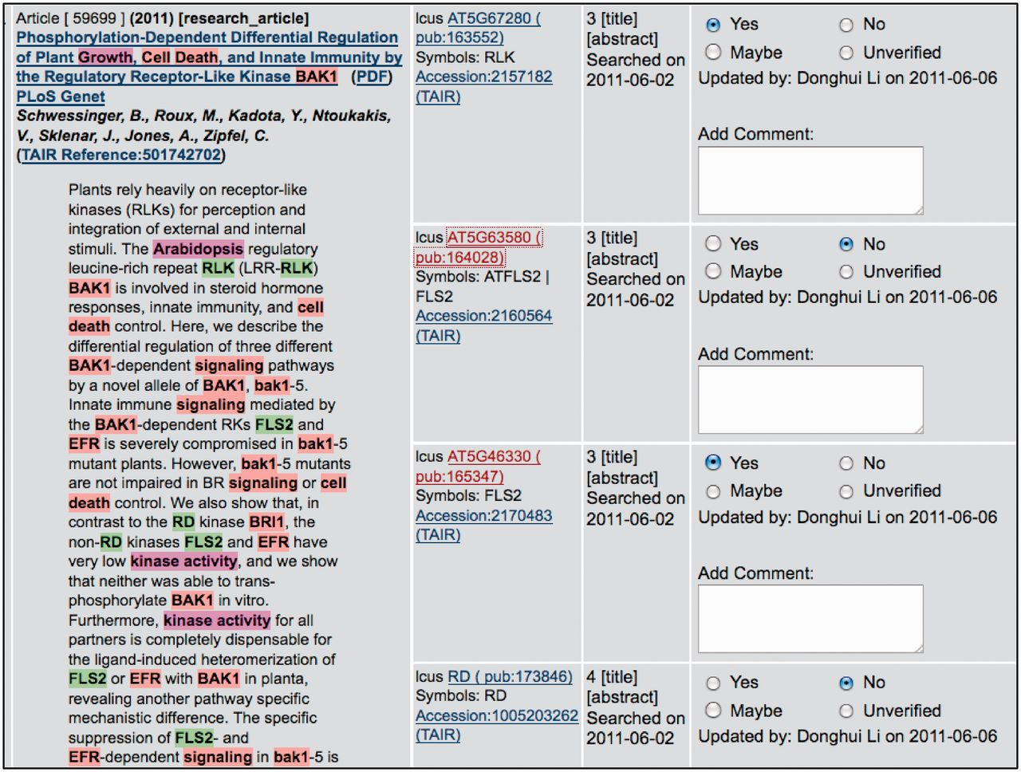
Figure 2 PubSearch gene name recognition interface. The left panel displays article abstract with various entities ...
Notes:
Figure 2 PubSearch gene name recognition interface. The left panel displays article abstract with various entities (gene name: e.g. FLS2, species name: e.g. Arabidopsis and keywords: e.g. kinase activity) highlighted. The highlighted entities are automatically identified by PubSearch. Candidate gene identifiers suggested by PubSearch are displayed in center panel. The right panel allows curators to record the results of manual verification. In this example, the symbol FLS2 in the abstract is mapped to two gene identifiers: AT5G63580 and AT5G46330. Curators link FLS2 to the correct gene identifier by analyzing the context in the abstract, as well as existing annotations to these two genes. Due to space constraint, this figure only displays a partial list of candidate gene identifiers suggested by PubSearch. For example, BAK1, which corresponds to AT4G33430 is not shown in this figure.
Unless provided in the caption above, the following copyright applies to the content of this slide: © The Author(s) 2012. Published by Oxford University Press.This is an Open Access article distributed under the terms of the Creative Commons Attribution License (http://creativecommons.org/licenses/by-nc/3.0/), which permits non-commercial reuse, distribution, and reproduction in any medium, provided the original work is properly cited. For commercial re-use, please contact journals.permissions@oup.com.

