Slide 1
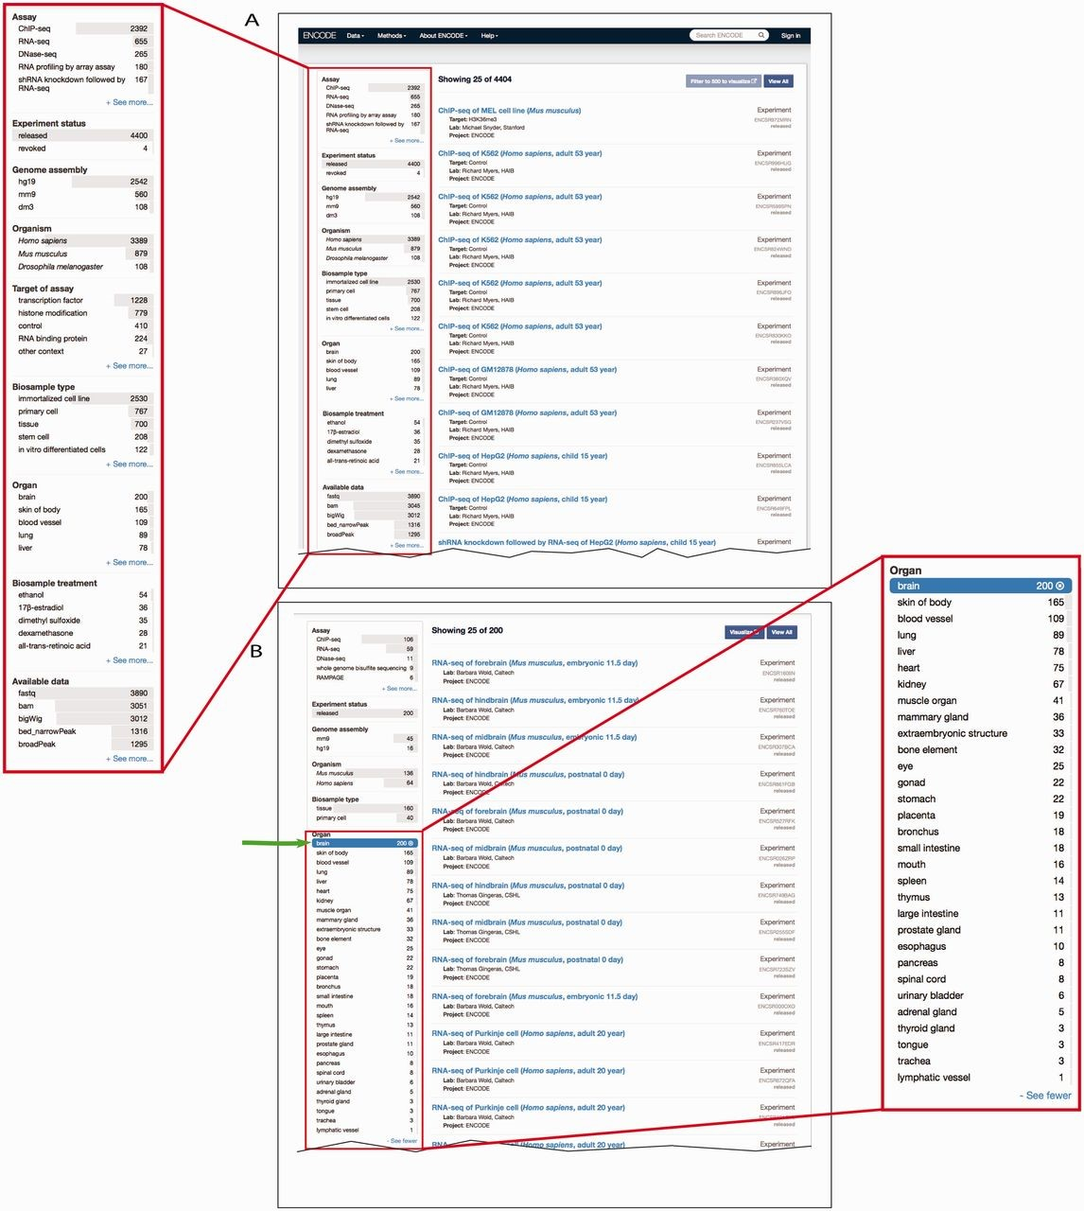
Figure 4. Filtering search results using facets. ( A ) A subset of facets for experimental assays is highlighted in ...
Notes:
Figure 4. Filtering search results using facets. ( A ) A subset of facets for experimental assays is highlighted in the left column of the interface ( https://www.encodeproject.org/search/?type=experiment ). The ‘Assay’ facet displays the term name for annotations of an experiment to an OBI term id. ‘Experiment status’ indicates the state of the experiment record in the database. The ‘Organ’ facet represents the biosample slim described in the text describes the anatomical structure. The ‘Biosample treatment’ facet displays the term names for treatments, some of which are annotated to ChEBI. Lastly, the ‘Available data’ facet describes the data file types that are available for download from the ENCODE portal. ( B ) In this example, the user has expanded the ‘Organ’ facet and selected ‘brain’. To the right are all the available experiments on biological samples annotated to a specific term in Uberon, CL or EFO that slims to the parent term brain—UBERON:0000955.
Unless provided in the caption above, the following copyright applies to the content of this slide: © The Author(s) 2015. Published by Oxford University Press.This is an Open Access article distributed under the terms of the Creative Commons Attribution License (http://creativecommons.org/licenses/by/4.0/), which permits unrestricted reuse, distribution, and reproduction in any medium, provided the original work is properly cited.

