Slide 1
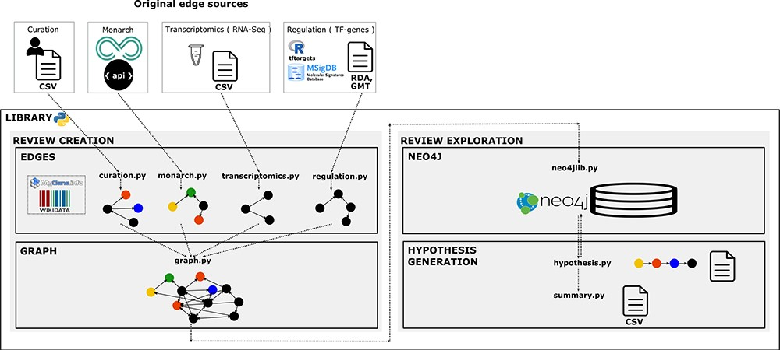
Figure 2 Library architecture. Architecture of the system based on four components. The edges component contains ...
Notes:
Figure 2 Library architecture. Architecture of the system based on four components. The edges component contains libraries with functions to collect, normalize and format the information and data resources we want to integrate as individual networks. The graph component contains functions to integrate and create the knowledge graph. The Neo4j component contains the module to import the graph into Neo4j. Finally, the hypothesis-generation component contains the modules to query the graph, structure the resulting semantic paths and extract summaries to analyse connections and the evidence.
Unless provided in the caption above, the following copyright applies to the content of this slide: © The Author(s) 2020. Published by Oxford University Press.This is an Open Access article distributed under the terms of the Creative Commons Attribution License (http://creativecommons.org/licenses/by/4.0/), which permits unrestricted reuse, distribution, and reproduction in any medium, provided the original work is properly cited.

