Slide 1
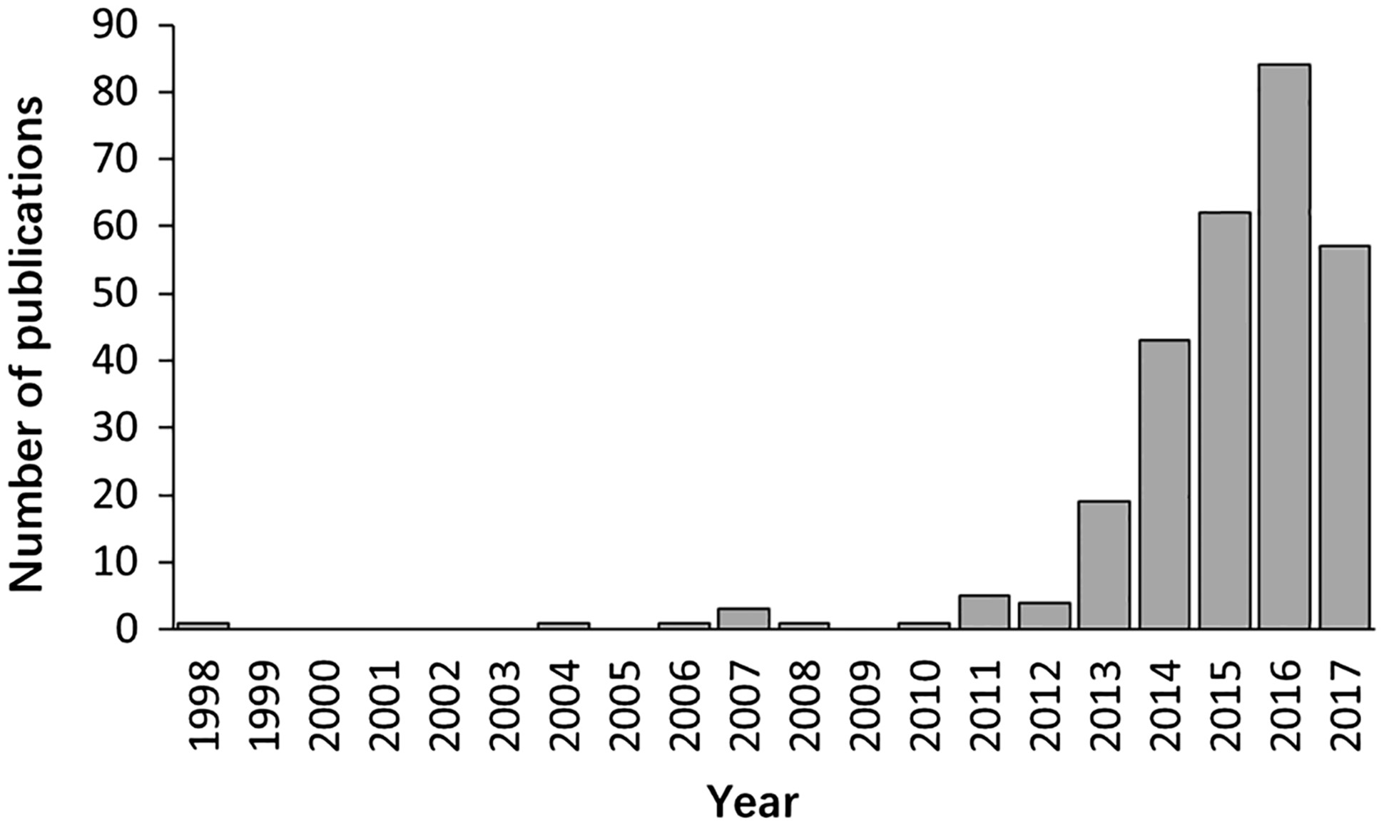
Figure 1. The distribution of papers included in the database by year of publication.
Notes:
Figure 1. The distribution of papers included in the database by year of publication.
Unless provided in the caption above, the following copyright applies to the content of this slide: © The Author(s) 2017. Published by Oxford University Press.This is an Open Access article distributed under the terms of the Creative Commons Attribution License (http://creativecommons.org/licenses/by/4.0/), which permits unrestricted reuse, distribution, and reproduction in any medium, provided the original work is properly cited.

Slide 2
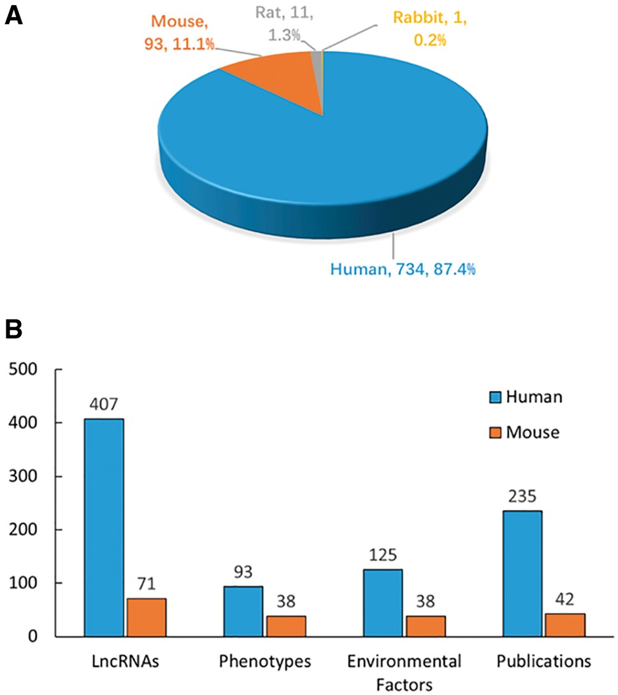
Figure 2. Statistics and distribution of data in DLREFD. (A) Entry distribution in different species. (B) Number of ...
Notes:
Figure 2. Statistics and distribution of data in DLREFD. (A) Entry distribution in different species. (B) Number of lncRNAs, phenotypes, EFs and publications for human and mouse.
Unless provided in the caption above, the following copyright applies to the content of this slide: © The Author(s) 2017. Published by Oxford University Press.This is an Open Access article distributed under the terms of the Creative Commons Attribution License (http://creativecommons.org/licenses/by/4.0/), which permits unrestricted reuse, distribution, and reproduction in any medium, provided the original work is properly cited.

Slide 3
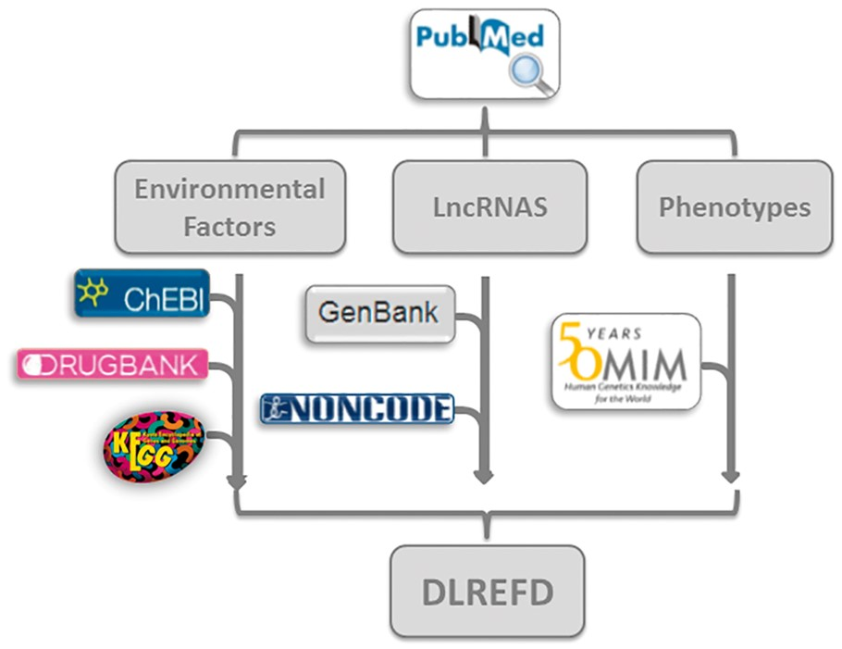
Figure 3. The flowchart of DLREFD construction. The ﬂowchart shows the process of data processing and information ...
Notes:
Figure 3. The flowchart of DLREFD construction. The ﬂowchart shows the process of data processing and information integration.
Unless provided in the caption above, the following copyright applies to the content of this slide: © The Author(s) 2017. Published by Oxford University Press.This is an Open Access article distributed under the terms of the Creative Commons Attribution License (http://creativecommons.org/licenses/by/4.0/), which permits unrestricted reuse, distribution, and reproduction in any medium, provided the original work is properly cited.

Slide 4
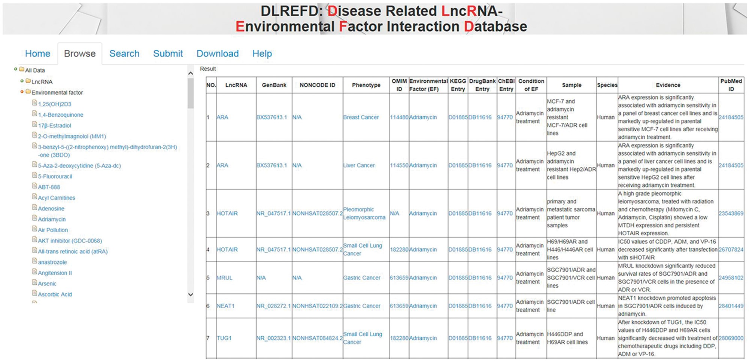
Figure 4. The NRDTD user interface showing the browse page.
Notes:
Figure 4. The NRDTD user interface showing the browse page.
Unless provided in the caption above, the following copyright applies to the content of this slide: © The Author(s) 2017. Published by Oxford University Press.This is an Open Access article distributed under the terms of the Creative Commons Attribution License (http://creativecommons.org/licenses/by/4.0/), which permits unrestricted reuse, distribution, and reproduction in any medium, provided the original work is properly cited.

Slide 5
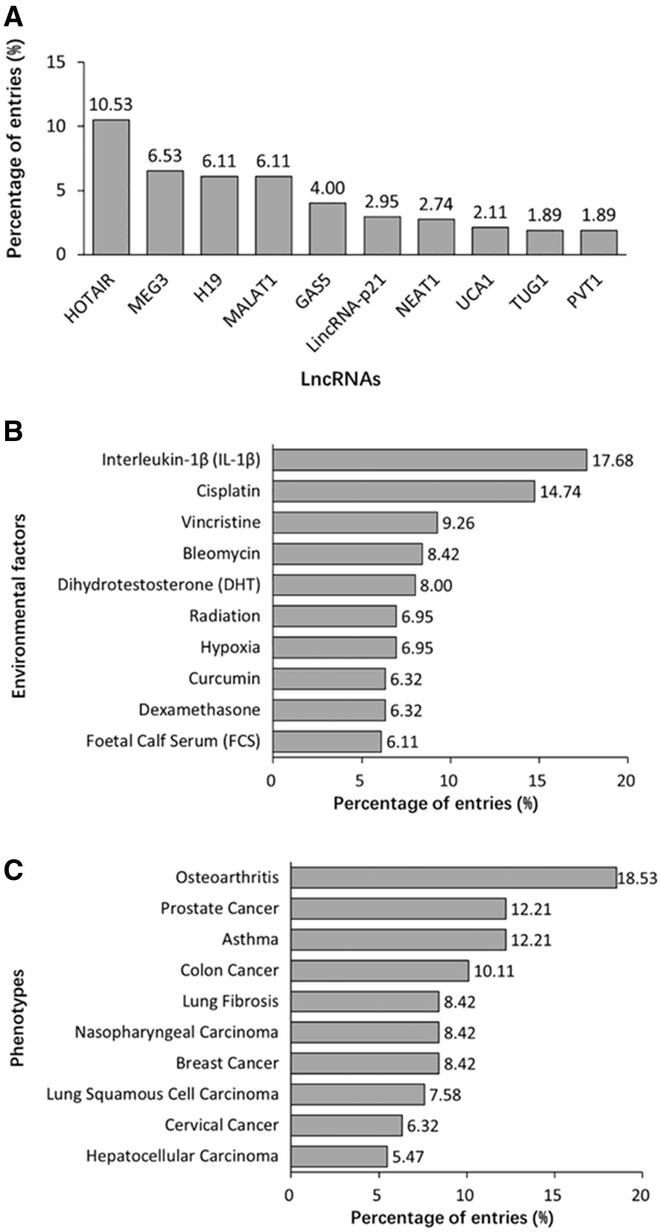
Figure 5. Summary statistics about lncRNA, EF and phenotype data registered in the database. (A) Distribution of top 10 ...
Notes:
Figure 5. Summary statistics about lncRNA, EF and phenotype data registered in the database. (A) Distribution of top 10 lncRNAs. (B) Distribution of top 10 EFs. (C) Distribution of top 10 phenotypes.
Unless provided in the caption above, the following copyright applies to the content of this slide: © The Author(s) 2017. Published by Oxford University Press.This is an Open Access article distributed under the terms of the Creative Commons Attribution License (http://creativecommons.org/licenses/by/4.0/), which permits unrestricted reuse, distribution, and reproduction in any medium, provided the original work is properly cited.

