Slide 1
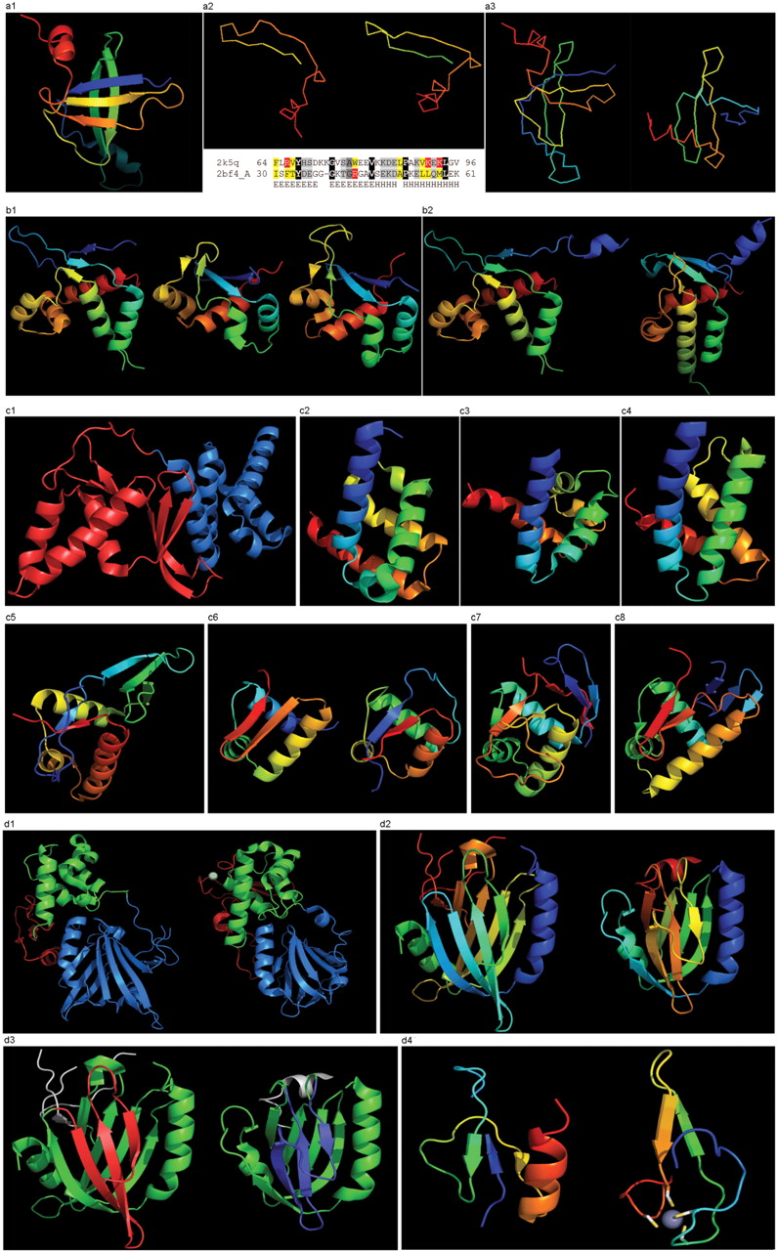
Figure 8. (a1) Cartoon diagram of T0467: 2k5q model 1, residues 7–97. (a2) Ribbon diagram of T0467 OB-fold C-terminal ...
Notes:
Figure 8. (a1) Cartoon diagram of T0467: 2k5q model 1, residues 7–97. (a2) Ribbon diagram of T0467 OB-fold C-terminal terminal region and Sso7d SH3-fold C-terminal region. Left: T0467 OB-fold C-terminal fragment: 2k5q model 1, residues 64–97; Right: Sso7d SH3-fold C-terminal fragment: 2bf4 chain A residues 30–64. On the bottom of this panel, a sequence alignment between 2k5q and 2bf4 indicates the sequence similarity between OB-fold and SH3-fold. (a3) Ribbon diagram of T0467 global OB-fold and Sso7d global SH3-fold. Left: T0467 OB-fold: 2k5q model 1, residues 7–97; Right: Sso7d SH3-fold: 2bf4 chain A. (b1) Cartoon diagram of T0465 and two typical proteins with FYSH domain. Left: Cartoon diagram of T0465, 3dfd chain A residues 21–136; Middle: FYSH domain of hypothetical protein AF0491: 1t95 chain A residues 11–94; Right: FYSH domain of hypothetical protein Yhr087W: 1nyn chain A residues 1–93. (b2) Cartoon diagram of T0465 and the closest template 2bo9. Left: Cartoon diagram of T0465: 3dfd chain A residues 11–137; Right: bacteriophage HK97 tail assembly chaperone: 2ob9 chain A. (c1) Cartoon diagram of T0443 evolutionary domains: 3dee, N- and C-terminal domains are colored blue and red, respectively. (c2) Cartoon diagram of N-terminal domain of T0443: 3dee residues 31–117. (c3) Middle domain of eIFα: 2aho chain B residues 96–176 belongs to SAM-domain fold. (c4) Four helices from a cyclin domain: 1gh6 chain B 648-733. (c5) Cartoon diagram of C-terminal domain of T0443: 3dee residues 118–230, HTH helices are orange-yellow and orange, ‘wing’ strands are blue and red (c6) Left: classic-winged HTH in biotin repressor: 1bia residues 1–63, HTH helices are green and yellow, ‘wing’ strands are orange and red; Right: circularly permuted HTH in Met aminopeptidase: 1b6a 378-446, HTH helices are yellow and orange, ‘wing’ strands are blue and red. (c7) 2nd HTH in cullin: 1ldj chains A:586–673, B:19–28, HTH helices are green and lime, ‘wing’ strands are yellow and orange, side β-sheet is red and blue. (c8) HTH domain of PhoB: 1qqi residues 10–104, HTH helices are green and yellow-orange, ‘wing’ strands are orange and red, side β-sheet is blue-cyan. (d1) Left: cartoon diagram of T0510 domains: 3doa, N-terminal, middle and C-domains are shown in blue, green and red, respectively; Right: cartoon diagram of MutM domains: 1ee8_A, N-terminal, middle and C-terminal domains are shown in blue, green and red, respectively, Zn ion is shown as a white ball. (d2) Left: N-terminal domain of 510: 3doa residues 1–165; Right: N-terminal domain of MutM: 1ee8 chain A residues 1–121. (d3) Left: N-terminal domain of 510: 3doa residues 1–165 insertion close to the N-terminus is red; Right: N-terminal domain of MutM: 1ee8 chain A residues 1–121 insertion in the middle of the domain is blue. (d4) Left: N-terminal domain of 510: 3doa residues 236–279; Right: N-terminal domain of MutM: 1ee8 chain A residues 230–266.
Unless provided in the caption above, the following copyright applies to the content of this slide: © 2009 The Author(s).This is Open Access article distributed under the terms of the Creative Commons Attribution Non-Commercial License (http://creativecommons.org/licenses/by-nc/2.0/uk/) which permits unrestricted non-commercial use, distribution, and reproduction in any medium, provided the original work is properly cited.

