Slide 1
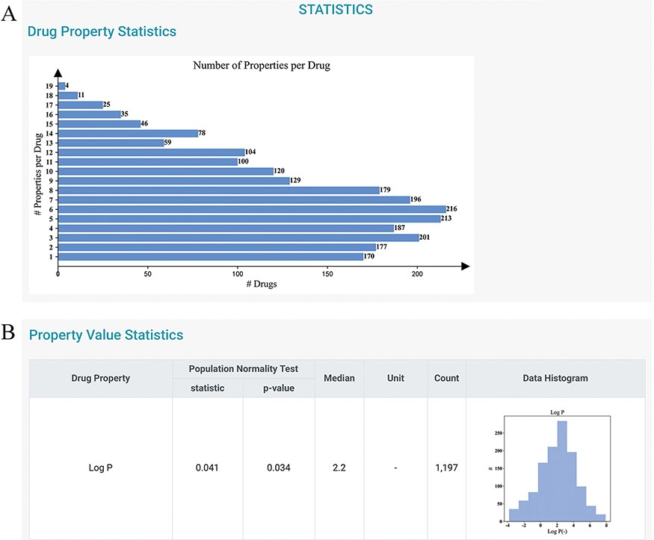
Figure 3. Statistics page of DDPD. (A) Barplot shows the number of properties per drug. (B) Property value statistics ...
Notes:
Figure 3. Statistics page of DDPD. (A) Barplot shows the number of properties per drug. (B) Property value statistics such as histogram for log P is provided. Log P of all drugs in our database is to some degree normally distributed with a median of 2.2 (normality test P-value = 0.034).
Unless provided in the caption above, the following copyright applies to the content of this slide: © The Author(s) 2022. Published by Oxford University Press.This is an Open Access article distributed under the terms of the Creative Commons Attribution License (https://creativecommons.org/licenses/by/4.0/), which permits unrestricted reuse, distribution, and reproduction in any medium, provided the original work is properly cited.

