Slide 1
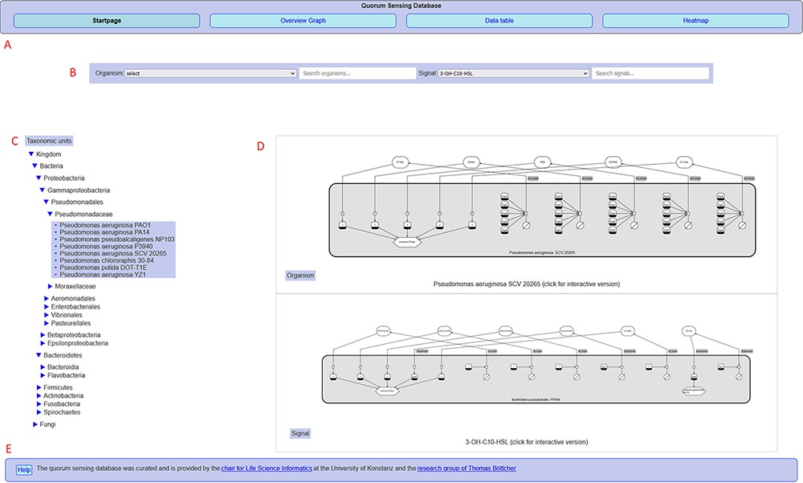
Figure 2. Overview of the QSDB user interface on the start page, showing (A) navigation menu to switch between the main ...
Notes:
Figure 2. Overview of the QSDB user interface on the start page, showing (A) navigation menu to switch between the main pages, (B) organism/signal search menu, (C) taxonomic hierarchy, (D) diagram previews and (E) footer with access to help page and further information.
Unless provided in the caption above, the following copyright applies to the content of this slide: © The Author(s) 2021. Published by Oxford University Press.This is an Open Access article distributed under the terms of the Creative Commons Attribution License (https://creativecommons.org/licenses/by/4.0/), which permits unrestricted reuse, distribution, and reproduction in any medium, provided the original work is properly cited.

Slide 2
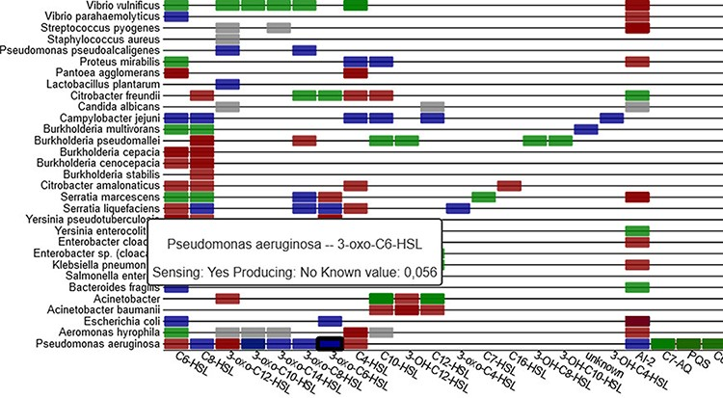
Figure 6. Sensing information between organisms and signal molecules is depicted in a heat-map (part shown), with ...
Notes:
Figure 6. Sensing information between organisms and signal molecules is depicted in a heat-map (part shown), with colour coding representing the different classes of mechanisms (sensing, producing, inhibiting and unclear).
Unless provided in the caption above, the following copyright applies to the content of this slide: © The Author(s) 2021. Published by Oxford University Press.This is an Open Access article distributed under the terms of the Creative Commons Attribution License (https://creativecommons.org/licenses/by/4.0/), which permits unrestricted reuse, distribution, and reproduction in any medium, provided the original work is properly cited.

Slide 3
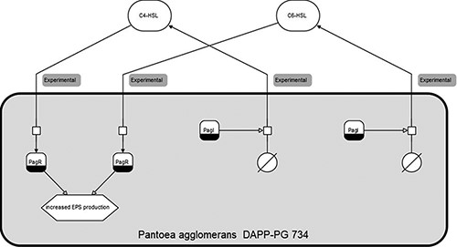
Figure 1. Clickable SBGN (Systems Biology Graphical Notation) diagram for Pantoea agglomerans DAPP-PG 734, with sensing ...
Notes:
Figure 1. Clickable SBGN (Systems Biology Graphical Notation) diagram for Pantoea agglomerans DAPP-PG 734, with sensing and producing mechanisms for both C6-HSL and C4-HSL.
Unless provided in the caption above, the following copyright applies to the content of this slide: © The Author(s) 2021. Published by Oxford University Press.This is an Open Access article distributed under the terms of the Creative Commons Attribution License (https://creativecommons.org/licenses/by/4.0/), which permits unrestricted reuse, distribution, and reproduction in any medium, provided the original work is properly cited.

Slide 4
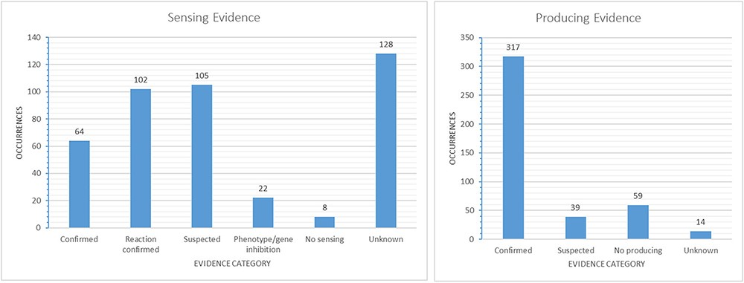
Figure 5. Evidence-based categories of the reported sensing and producing mechanisms: confirmed, suspected, evidence of ...
Notes:
Figure 5. Evidence-based categories of the reported sensing and producing mechanisms: confirmed, suspected, evidence of a reaction to a signal without certainty about a receptor involved (sensing only), inhibition of a phenotype or gene through a signal (sensing only), no sensing or producing (e.g. only producing/sensing) and unknown.
Unless provided in the caption above, the following copyright applies to the content of this slide: © The Author(s) 2021. Published by Oxford University Press.This is an Open Access article distributed under the terms of the Creative Commons Attribution License (https://creativecommons.org/licenses/by/4.0/), which permits unrestricted reuse, distribution, and reproduction in any medium, provided the original work is properly cited.

Slide 5
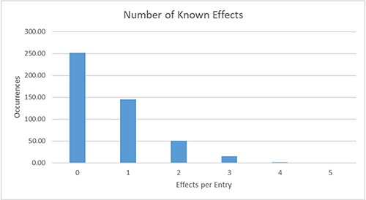
Figure 4. Distribution of the number of known effects per database entry. For 145 entries, exactly one effect is ...
Notes:
Figure 4. Distribution of the number of known effects per database entry. For 145 entries, exactly one effect is currently described; for 69 further entries, more than one effect is already known.
Unless provided in the caption above, the following copyright applies to the content of this slide: © The Author(s) 2021. Published by Oxford University Press.This is an Open Access article distributed under the terms of the Creative Commons Attribution License (https://creativecommons.org/licenses/by/4.0/), which permits unrestricted reuse, distribution, and reproduction in any medium, provided the original work is properly cited.

Slide 6
Figure 3. Highest numbers of occurrences for species (A) and signals (B) in the database (only values of at least 10 ...
Notes:
Figure 3. Highest numbers of occurrences for species (A) and signals (B) in the database (only values of at least 10 are shown).
Unless provided in the caption above, the following copyright applies to the content of this slide: © The Author(s) 2021. Published by Oxford University Press.This is an Open Access article distributed under the terms of the Creative Commons Attribution License (https://creativecommons.org/licenses/by/4.0/), which permits unrestricted reuse, distribution, and reproduction in any medium, provided the original work is properly cited.

