Slide 1
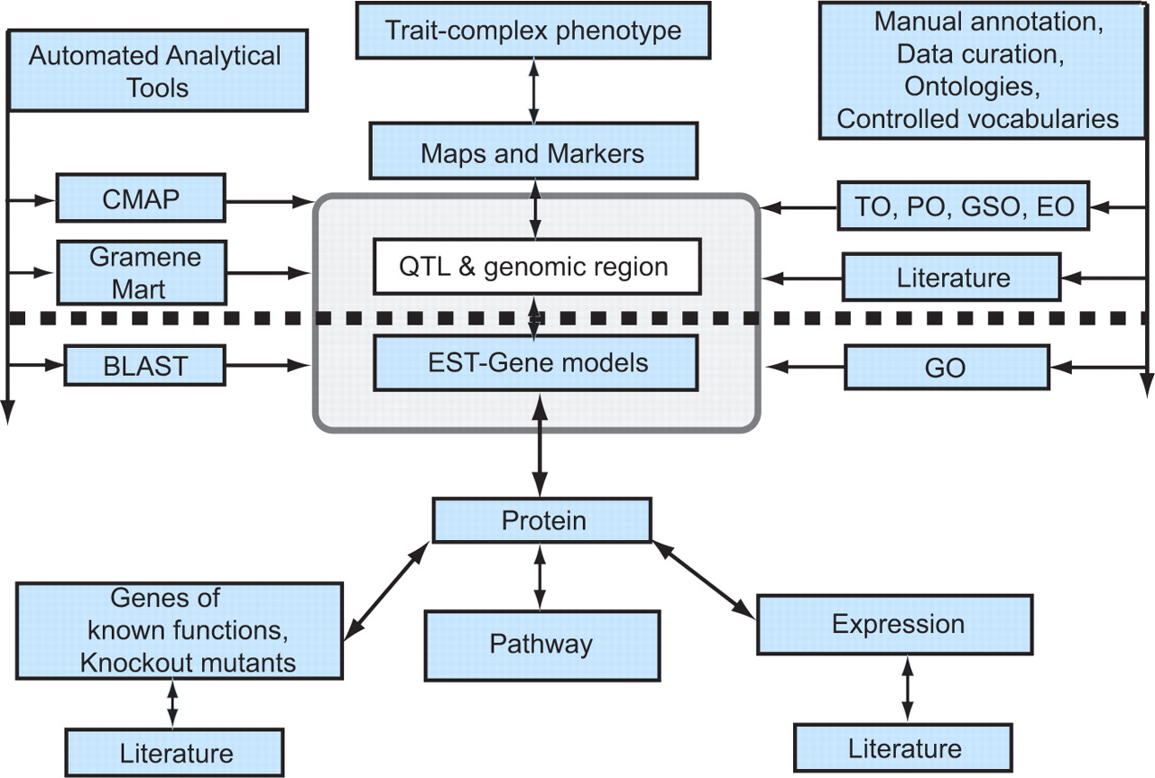
Figure 2. Generalized model for candidate gene discovery. The diagram shows a simplified view of the information ...
Notes:
Figure 2. Generalized model for candidate gene discovery. The diagram shows a simplified view of the information modules in the Gramene database. The figure has been designed to show the path of forward genetic dissection of complex traits above the dotted line and reverse genetic investigation below the heavy dotted line. In reality, as indicated by the arrows, the database can be accessed from any point of entry and users can navigate to the required information. Gramene provides automated analytical tools shown to the left of the pale grey box, and manual curation using ontologies and controlled vocabularies shown to the right of the dotted box, to enhance the data mining potential of the database. The association between the QTL and EST modules contained within the pale grey box highlights the fact that a user can systematically zero in on information about the relationship between a complex phenotype and a candidate gene/s of interest. As depicted here, a trait or complex phenotype is associated through maps and markers to a genomic region identified as a QTL and to ESTs and gene models previously annotated to the genome region; the QTL database thus performs the crucial function of connecting molecular or genotypic information with complex phenotypes, and more generally connecting the field of molecular biology with that of quantitative genetics and plant breeding.
Unless provided in the caption above, the following copyright applies to the content of this slide: © 2009 The Author(s).This is Open Access article distributed under the terms of the Creative Commons Attribution Non-Commercial License (http://creativecommons.org/licenses/by-nc/2.0/uk/) which permits unrestricted non-commercial use, distribution, and reproduction in any medium, provided the original work is properly cited.

