Slide 1
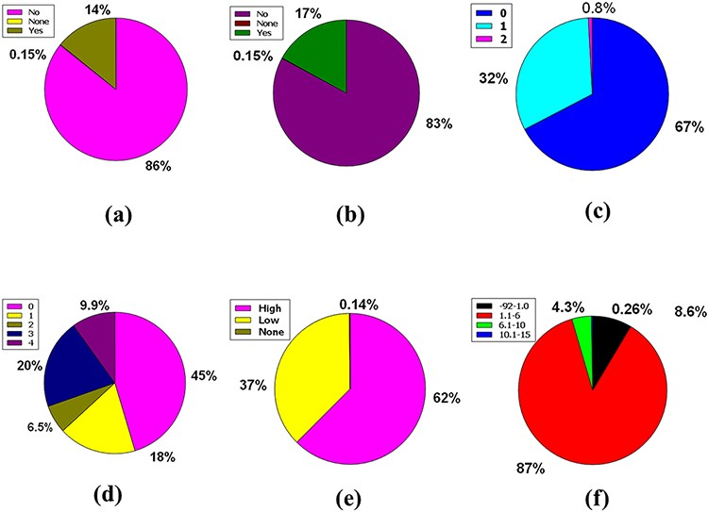
Figure 5. Venn diagram plot demonstration of the physicochemical properties of phytochemicals in ‘phytochemdb’ ...
Notes:
Figure 5. Venn diagram plot demonstration of the physicochemical properties of phytochemicals in ‘phytochemdb’ database: percentages of (a) CYP2D6, (b) CYP3A4 inhibitors and non-inhibitors of phytochemicals; (c) proportions of compounds that fulfil diverse criteria of Egan rule; (d) percentages of phytochemicals according to the Ghose filter; (e) gastrointestinal (GI) absorption rate of compounds; (f) percentages of phytochemicals that satisfy diverse iLOGP (lipophilicity) score.
Unless provided in the caption above, the following copyright applies to the content of this slide: © The Author(s) 2022. Published by Oxford University Press.This is an Open Access article distributed under the terms of the Creative Commons Attribution License (https://creativecommons.org/licenses/by/4.0/), which permits unrestricted reuse, distribution, and reproduction in any medium, provided the original work is properly cited.

