Slide 1
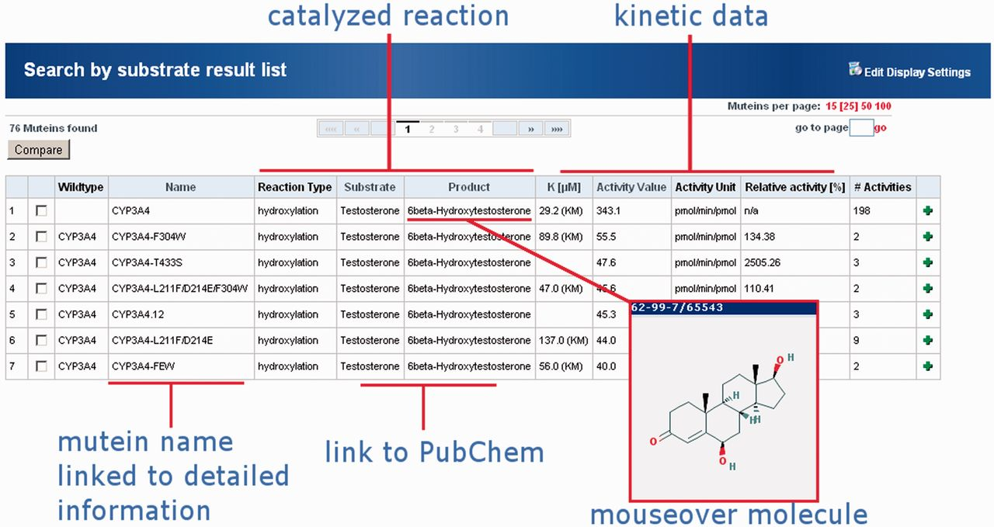
Figure 3 Result display of the MuteinDB web-interface for testosterone as a substrate. Information within the result ...
Notes:
Figure 3 Result display of the MuteinDB web-interface for testosterone as a substrate. Information within the result listing for each mutein is by default grouped into catalyzed reaction and kinetic data. Reaction information comprises the reaction type as well as the catalyzed substrate and product. Molecules are directly linked to their corresponding PubChem entry. Additionally, the molecule structure can be displayed by moving over the compound’s name. Important kinetic parameters such as K value, activity value including its unit as well as the relative activity in (%) are directly available in the result view. All presented information and further links for each mutein or wild type is directly linked by its name.
Unless provided in the caption above, the following copyright applies to the content of this slide: © The Author(s) 2012. Published by Oxford University Press.This is an Open Access article distributed under the terms of the Creative Commons Attribution Non-Commercial License (http://creativecommons.org/licenses/by-nc/3.0), which permits unrestricted non-commercial use, distribution, and reproduction in any medium, provided the original work is properly cited.

