Slide 1
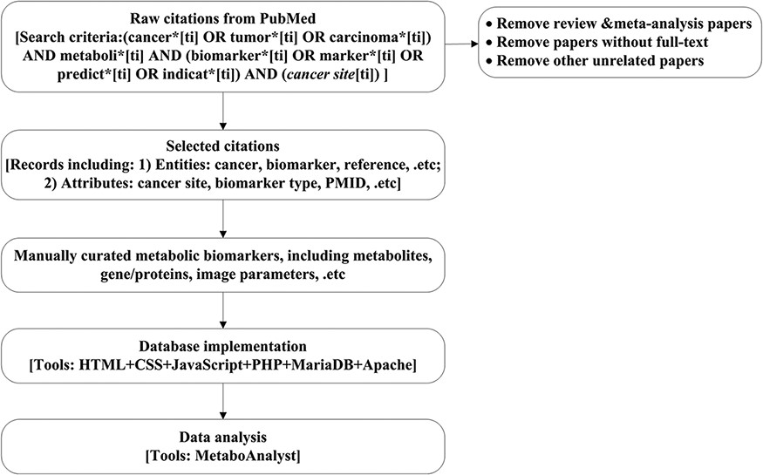
Figure 1. Work flow chart. Here, the cancer site will be specific to cancer site searched, e.g. breast, prostate and ...
Notes:
Figure 1. Work flow chart. Here, the cancer site will be specific to cancer site searched, e.g. breast, prostate and lung. Details for search criteria and result are shown in supplementary file 1.
Unless provided in the caption above, the following copyright applies to the content of this slide: © The Author(s) 2021. Published by Oxford University Press.This is an Open Access article distributed under the terms of the Creative Commons Attribution License (http://creativecommons.org/licenses/by/4.0/), which permits unrestricted reuse, distribution, and reproduction in any medium, provided the original work is properly cited.

